Slide 1

Geothermal Systems
open loop and closed loop Heat exchangers For geothermal systems
Except where otherwise noted these materials
are licensed Creative Commons Attribution 4.0 (CC BY)

Slide 2
Objectives
The objective of this unit is to present the student with the basic geothermal terms and an understanding of heat exchangers used and how they are incorporated into the system. Upon completion, the student will have an understanding of the following:
Basic geothermal terminology
The basic layout of different loop configurations
Series and parallel piping
Ground temperature zones
Thermal conductivity tests
Open and closed loops

Slide 3
Ground Source Heat Pumps Compared to Air Source Heat Pumps
The closed loop configurations provide a reliable way to achieve geothermal efficiencies when
  Well water is not available.
  If the water is of poor quality
  Not able to use because of codes
The ground heat exchanger portion uses the constant temperatures as a means of efficiently exchanging heat between the soil and heat pump.
  Summer example would be a standard home.
          An air source air conditioner on a hot day may have to reject heat to 95°F air while the ground may be 70°F.
          A 25°F difference makes the heat pump more efficient.
  Winter example of this would be the air source heat pump
          Working with an air temperature of 20°F.
          Ground is at 45°F; it is starting 25°F warmer.
          Allows for less work, making it more efficient
          Saves energy costs

Slide 4
Heat Pump Basics
Certain laws govern all of nature.
Heat pumps are built on these laws where hot and cold are relative terms.
Heat exists at all temperatures all the way down to absolute zero, -460°F.
Heat flows from a region of higher temperature to a region of lower temperature, regardless of temperature difference.
All gasses become warmer when they are compressed.
Matter exists as a solid, liquid, or gas.
The temperature at which a material changes from a liquid to a gas (evaporates) or a gas to a liquid (condenses) depends on the current pressure of the material.
All technicians troubleshoot on these concepts even if they do not realize it.

Slide 5
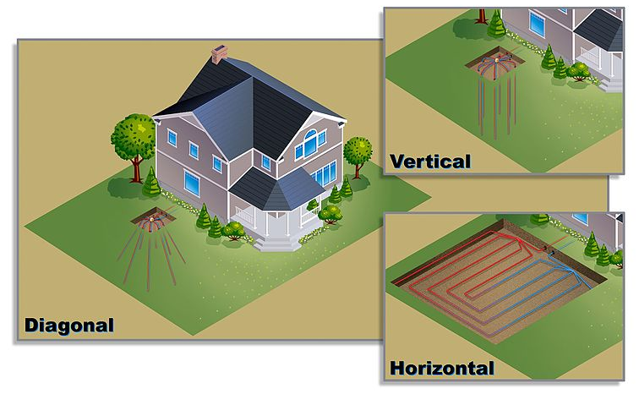
Geothermal
Loop Configurations
WGisol. 2015. [CC-BY 4.0] Retrieved from https://en.wikipedia.org/wiki/File:ETI-FS_Loop_Diagrams,_01.26.11.jpg

Slide 6
Geothermal Design Basics
Soil conditions and characteristics differ across regions and can even differ across a job site. Some possible variations may include:
  Large compositions of rock to mainly soil
  Moisture content of the soil
    Moisture content is influenced by regional weather.
    Variations in the water table (static water level)
Regardless of the variables that cause change, it is clear that along with these variables is a change in thermal properties.
The “Thermal Property” of a substance refers to its temperature and its ability to conduct or transfer energy.
At approximately 50 feet below the surface, the temperatures are constant; however, above that, the temperature fluctuates. This is the area where geothermal heat exchangers transfer heat.
  Therefore, when designing a low energy geothermal system, one must take into account soil temperatures.

Slide 7
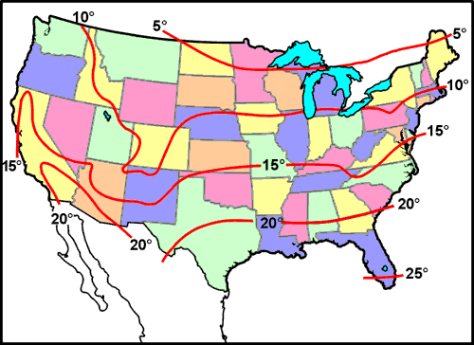
Geothermal Design Basics
Geothermal design software will use deep earth formation temperatures for vertical heat exchangers, and for horizontal, the software
will use subsurface
temperatures
(temperatures adjusted
for seasonal influences).
Environmental Protection Agency. [Public Domain]. Retrieved from https://www3.epa.gov/ceampubl/learn2model/part-two/onsite/tempmap.html

Slide 8
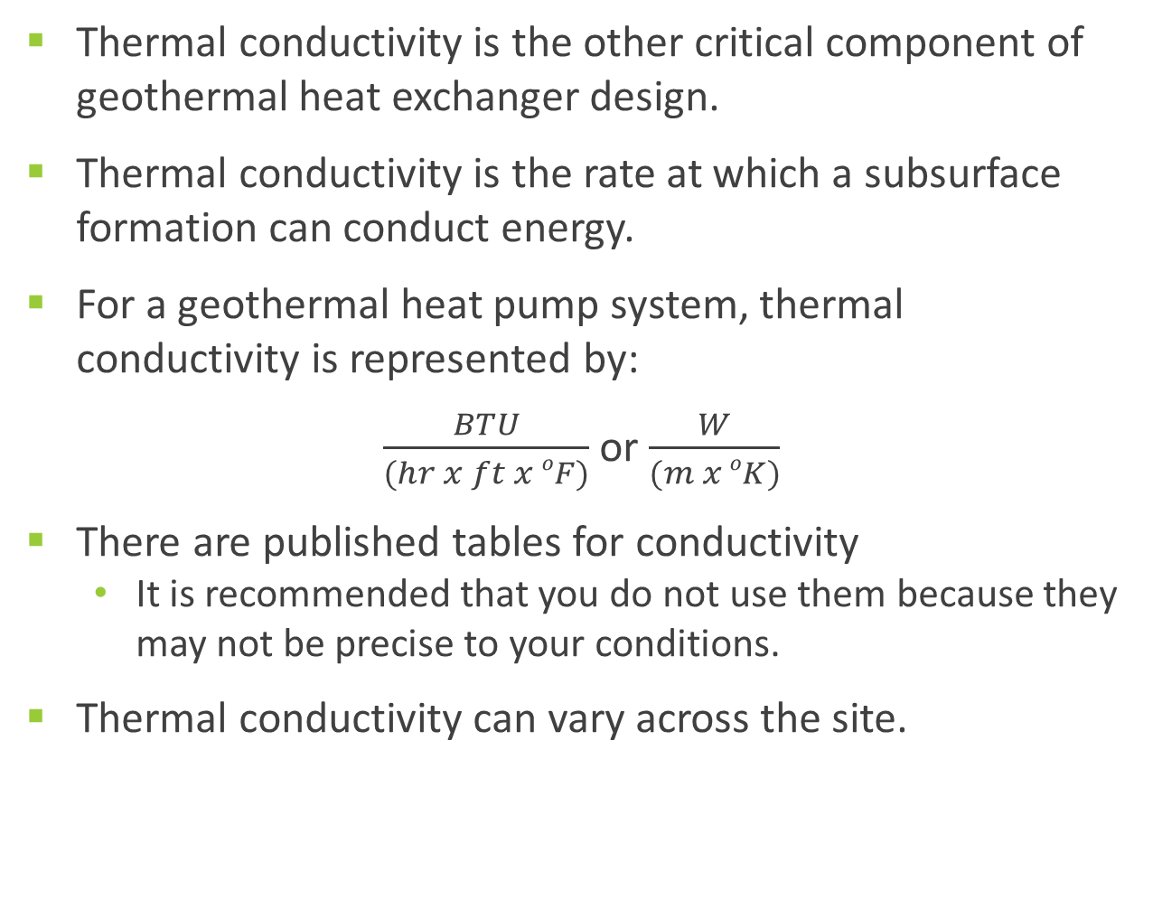
Geothermal Design Basics
Thermal conductivity is the other critical component of geothermal heat exchanger design.
Thermal conductivity is the rate at which a subsurface formation can conduct energy.
For a geothermal heat pump system, thermal conductivity is represented by:
$\frac{BTU}{(hr x ft x oF)}$ or $\frac{W}{(m x oK)}$
There are published tables for conductivity
  It is recommended that you do not use them because they may not be precise to your conditions.
Thermal conductivity can vary across the site.

Slide 9
Open
Loop
Configurations
An open loop geothermal system will use a well or return water to the water table through a drainage ditch.
  Provides a cost-effective way, using a ground source heat pump
  By using a constant water temperature provided by well water, the system is capable of uniform capacity and high efficiency in heating and cooling.
  Open loop systems operate at substantially higher temperatures and are not subject to the same extremes as a closed loop.
  Since it is open, the water quality needs to be determined and maintained at the highest level to prevent fouling.

Slide 10
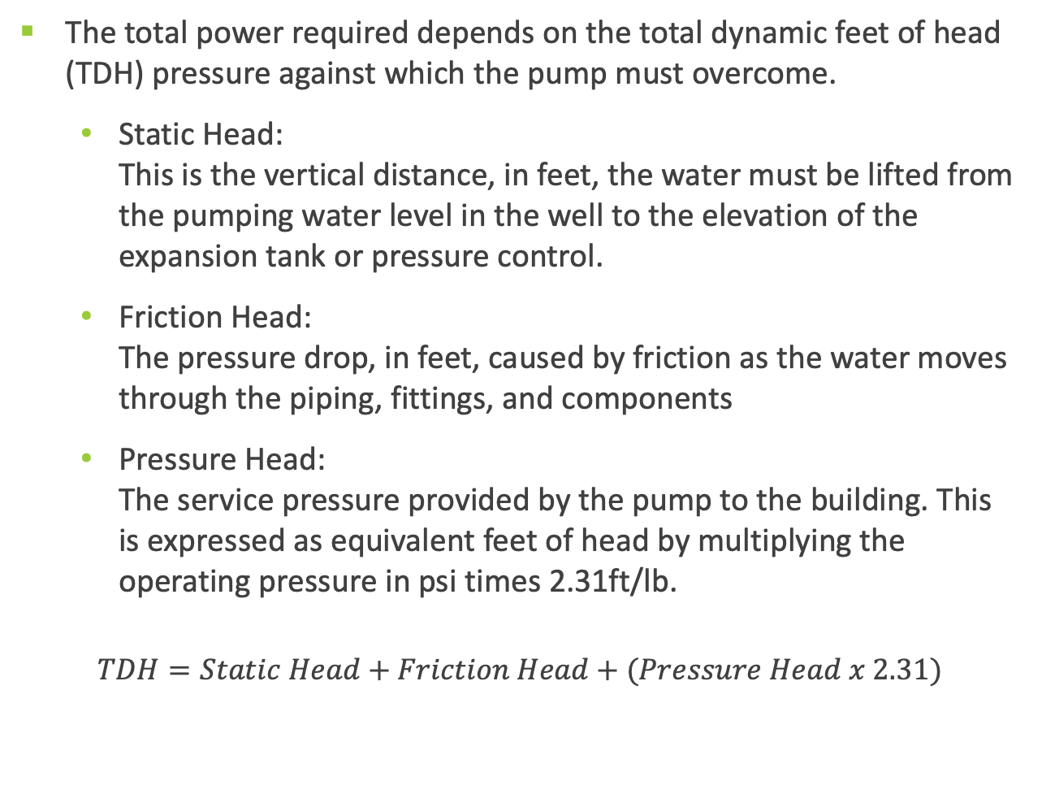
Pumping
Power
The total power required depends on the total dynamic feet of head (TDH) pressure against which the pump must overcome.
        Static Head:
        This is the vertical distance, in feet, the water must be lifted from the pumping water level in the well to the elevation of the expansion tank or pressure control.
        Friction Head:
        The pressure drop, in feet, caused by friction as the water moves through the piping, fittings, and components
        Pressure Head:
        The service pressure provided by the pump to the building. This is expressed as equivalent feet of head by multiplying the operating pressure in psi times 2.31ft/lb.
  $$TDH=Static Head+Friction Head+(Pressure Head x 2.31)$$

Slide 11
Pumping
Power
Example
Assume an application for a 3-ton open loop geothermal system.
  Water flow rate = 6 gpm
  Water pumping level = 100 ft
  Water supply pressure = 60 psi x 2.31 ft/psi = 138
  Piping pressure drop = 12ft of head
  TDH = 100 + 138 + 12 = 250 ft of head
Review the pump manufacture data and select a pump capable of 250ft TDH = 54 W per gpm of pump capacity
        Pump power average 54W/gpm x 6gpm = 324 W/hr
        The same 3-ton system in a closed loop would be 385W/hr, because the pump would require a high head loop pump.

Slide 12
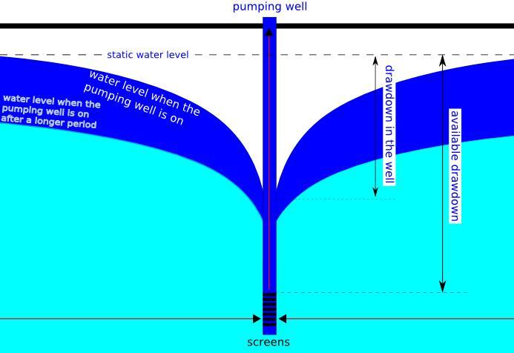
Open Loop
Drawdown
Test
A drawdown test is performed on a well to determine the change in water level between the static water level (when pump is off) and the pumping water level.
  The water level will drop when the pump goes on, which will create a cone of depression.
  A minimal drawdown in a well, typically less than 30 feet for wells with a deep pump setting
  The well with a minimum drawdown will be the most dependable well.
[ 3 ]
Didiervberghe [Public domain]. Retrieved from https://commons.wikimedia.org/wiki/File:Cross_section_of_a_drawdown_cone_of_a_pumping_well.JPG

Slide 13
Common Loop
Designs
Vertical loops
    Single-bore loops
    Multiple-bore series loops
    Multiple-bore parallel loop
      Reverse return
    For economic reasons, it is generally accepted that a depth of 50 feet is the practical minimum.
Horizontal directional-bore loops
    Allows for an installation without disturbing the surface
    Requires a moist clay or silty clay soil for success
    Boring lengths range from 160 to 300 feet per ton.
      A ton of air conditioning is 12,000 Btu’s.

Slide 14
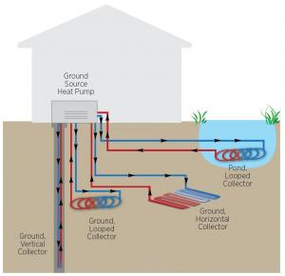
Common
Loop
Designs
Series/Parallel
U.S. Department of Energy. [Public Domain]. Retrieved from https://basc.pnnl.gov/resource-guides/geothermal-heat-pumps#quicktabs-guides=0

Slide 15
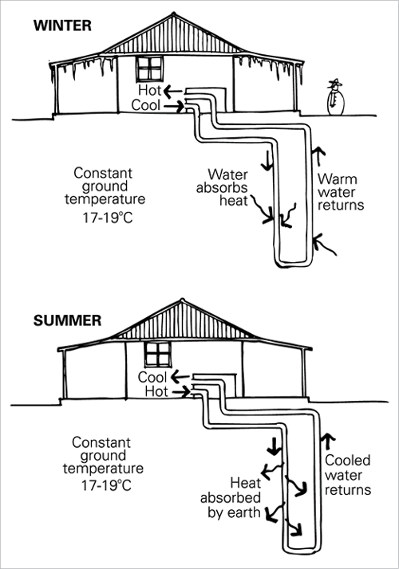
Common Vertical
Loop Designs
[ 6 ]
G. Milne, C. Reardon, P. Ryan, M. Pavia [Public domain]. Retrieved from http://www.yourhome.gov.au/energy/heating-and-cooling
Notes:
Where space is limited, the sealed piping loop can be inserted in small holes (150-400 feet deep) installed using a well-drilling rig.

Slide 16
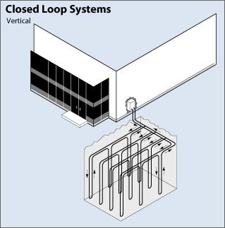
Common Vertical
Loop Designs:
Reverse/Return
Reverse return is a parallel design where the flow is equalized between the supply and return line.
  The first circuit on the supply manifold becomes the last circuit on the return manifold.
  All circuits will maintain the same pressure drop.
  Each circuit will receive the flow, regardless of circulation
  volume.
U.S. Department of Energy. [Public Domain]. Retrieved from https://basc.pnnl.gov/resource-guides/geothermal-heat-pumps#quicktabs-guides=1

Slide 17
Common Loop
Designs:
Horizontal
Trench Loops
Single-pipe, single-trench loops
    The loop is placed in a narrow trench commonly 4-6 inches in width.
    Common burial depth of 4-6 feet
    The loop should be positioned to allow for natural drainage: this will enhance heat transfer.
National Institutes of Health [Public domain]. Retrieved from https://www.orf.od.nih.gov/PoliciesAndGuidelines/Documents/Technical%20Bulletins/Ground%20Source%20Heat%20Pumps%20Part%20I%20of%20III%20Overview%20July%202013%20Bulletin_508.pdf

Slide 18
Common Loop
Designs:
Multiple-Pipe Single-Trench Loops
Variation of a single pipe
Common burial is 6 feet for the bottom pipe and 4 feet for the top.
This design will require less trenching but more pipe.
Thermal interference can occur in this application. The installer needs to make sure the top pipe is the outgoing pipe, and the return pipe is the lower pipe.
Helps promote a
counterflow heat
exchange
Ohio Water Resources Council [Public domain]. Retrieved from https://epa.ohio.gov/portals/28/documents/sccgw/GHCS.pdf

Slide 19
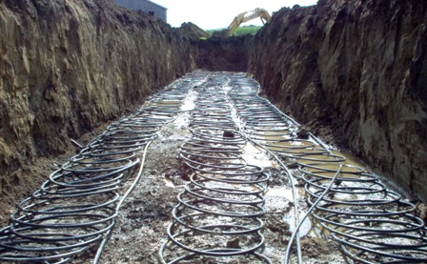
Common Loop
Designs:
Slinky Loops
Relatively new in the geothermal field
Advantages include:
  Needed heat transfer can be attained in a shorter/wider trench
  Worker hazard is reduced since it is a wider trench.
  Less trenching is required compared to a double-loop.
Disadvantage
  Careful consideration is required for soil types: a dry soil may require up to 1,000 per ton of cooling.
Mark Johnson. [Public domain]. Retrieved from https://commons.wikimedia.org/wiki/File:3-ton_Slinky_Loop.jpg

Slide 20
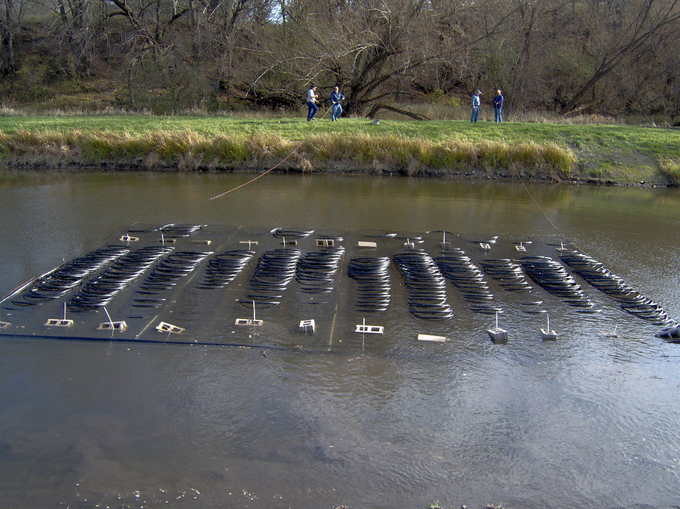
Common Loop
Designs:
Pond Loop
Provides an economical alternative to horizontal or vertical loops
Heat transfer provided by the direct water contact that creates convection currents.
Convection currents are created by the thermal difference between the pond water and loop.
This is more efficient than a horizontal earth loop.
Can lead to a 50% reduction in length compared to a horizontal earth loop
Mark Johnson. [Public Domain]. Retrieved from https://commons.wikimedia.org/wiki/File:Pond_Loop_Being_Sunk.jpg

Slide 21
Conclusions
Upon completion of this unit, students should be able to
Define ground source and air source heat pumps
Define heat pump basics for design
Describe a thermal conductivity test
Explain how an open loop system works
Explain the significance of a drawdown test
Explain the difference between different closed loop configurations
Explain reverse return piping
Discuss the significance of the soil characteristics
“This presentation was prepared by Northeast Iowa Community College under award EG-17-004 from the Iowa Energy Center. Any opinions, findings, and conclusions or recommendations expressed in this material are those of the author(s) and do not necessarily reflect the views of the Iowa Energy Center.”

