Slide 1

Solar photovoltaics
Solar radiation
Except where otherwise noted these materials
are licensed Creative Commons Attribution 4.0 (CC BY)

Slide 2
Objectives
The objective of this unit is to present the student with some basic terms relating to solar PV technology. Upon completion, the student will have an understanding of the following:
Define basic terms related to solar radiation
Describe the sun’s daily and yearly path
Determine the difference between True South and magnetic (compass) South
Name the factors that influence the energy output of a PV system
Identify the instruments used to measure solar power

Slide 3
Solar photovoltaics
Photovoltaics (PV)
  The conversion of light into electricity using semiconducting materials that exhibit the photovoltaic effect, a phenomenon studied in physics, photochemistry, and electrochemistry.
Typical Photovoltaic Systems employ
  Solar panels, each comprising a number of solar cells, which generate electrical power.
  PV installations may be ground-mounted, rooftop mounted, or wall mounted.
  The mount may be fixed or may use a solar tracker to follow the sun across the sky.

Slide 4
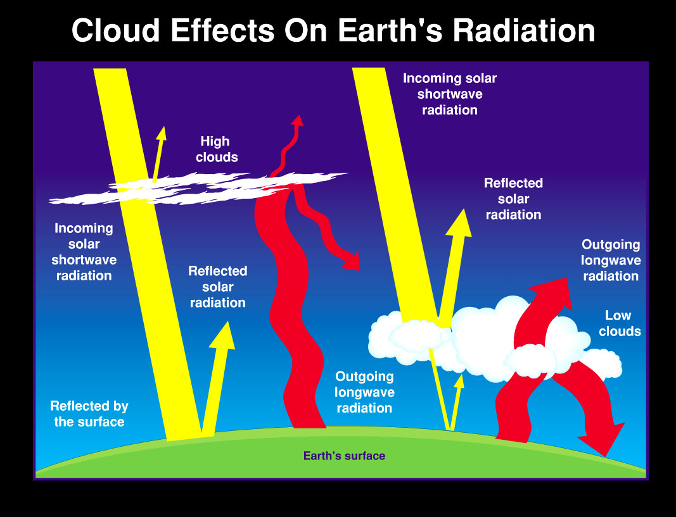
Solar Irradiance (watts/m²)
Solar irradiance is the sunlight intensity measured in watts or kW on one square meter. It is an instant snapshot of power.
Changes throughout the day based on the movement of the sun and cloud cover
In optimal conditions (middle of a clear sunny day), 1000 watts per meter or energy is available.
CERES Instrument Team [Public domain]. Retrieved from https://commons.wikimedia.org/wiki/File:NASA_graphic_representing_the_distribution_of_solar_radiation.jpg

Slide 5
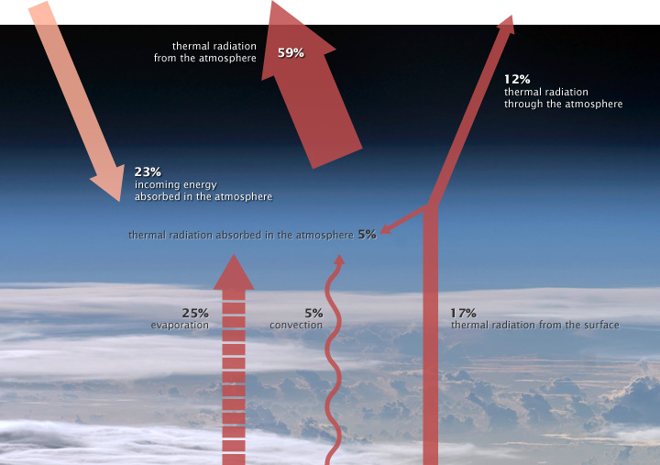
Insolation
The amount of solar energy on a surface over a period of time, measured in watt-hours or (kilowatt-hours) per square meter (Wh/m² or kWh/m² ).
Insolation is cumulative irradiance over a given time.
NASA illustration by Robert Simmon [Public Domain]. Retrieved from https://earthobservatory.nasa.gov/features/EnergyBalance/page1.php

Slide 6
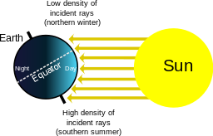
Solar Declination
Rhcastilhos [Public domain]. Retrieved from https://commons.wikimedia.org/wiki/File:Seasons.svg
The earth's equator is tilted 23.45 degrees with respect to the plane of the earth's orbit around the sun, so at various times during the year, as the earth orbits the sun, declination varies from 23.45 degrees north to 23.45 degrees south.

Slide 7
Solar Array Tilt Angle
Arranging Solar Panels or the array perpendicular to the sun’s rays as the seasons change allows them to collect the most energy.
The more direct the sun’s rays hit the solar panels, the more concentrated the radiation is and less reflection off the panels.
Seasons youtube link https://www.youtube.com/watch?v=WgHmqv_- UbQ
Iowa Energy Center. Solar PV Energy Guide. Retrieved from https://www.iowaeconomicdevelopment.com/userdocs/programs/15302_IEC_SolarEnergyGuide_Web.pdf

Slide 8
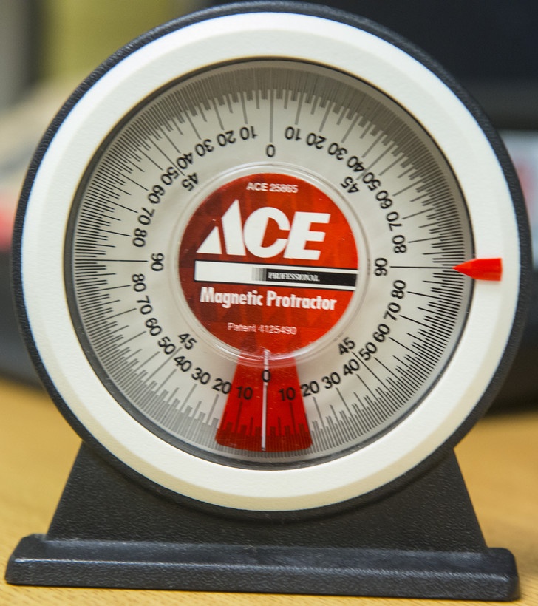
Inclinometer
Airman st Class Ceaira Tinsley [Public Domain]. Retrieved from https://www.moody.af.mil/News/Photos/igphoto/2000934140/
An inclinometer is a simple device used to measure an incline, such as a roof, or when building a solar array in order to reach the right pitch for the greatest efficiency.

Slide 9
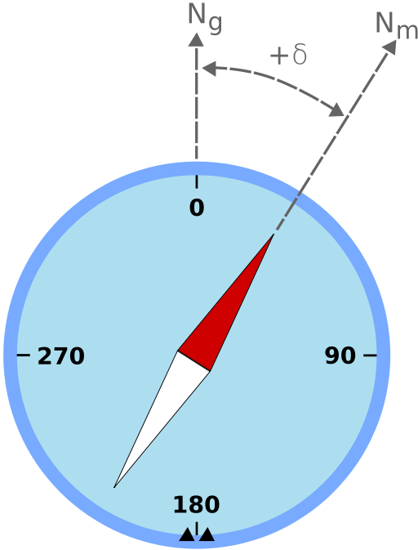
Magnetic declination
When a person holds up a compass, he or she isn't really finding “true” north or south. One can only find “magnetic south,” which is the direction towards the South Pole of our earth's geomagnetic field. Believe it or not, this point actually moves a few miles each year because the molten metal in the earth sloshes around.
The difference between True and magnetic South is called Magnetic Declination.
odder [CC BY-SA 3.0]. Retrieved from https://commons.wikimedia.org/wiki/File:Magnetic_declination.svg

Slide 10
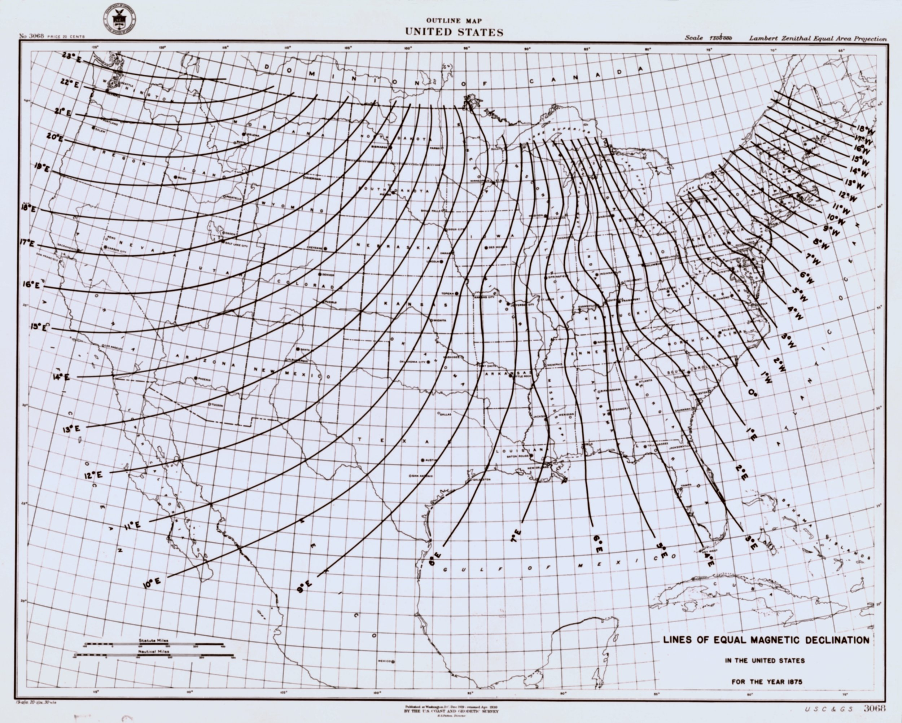
Magnetic declination
Magnetic declination varies by location.
On the North American map, Magnetic South and true South are the same at the zero line.
It roughly follows the Mississippi River Valley.
In Maine, subtract almost 20 degrees from the compass South to reach True South; whereas, in Washington, one would need to add 20 degrees.
NOAA's Historic Coast & Geodetic Survey Collection (Image cgs00122) [Public Domain]. Retrieved from https://www.photolib.noaa.gov/htmls/cgs00122.htm

Slide 11
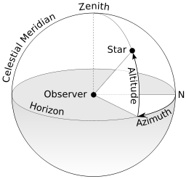
Solar Azimuth Angle
Solar Azimuth Angle: The sun’s position East or West of true South and is measured in degrees.
From the Northern hemisphere, East is 90⁰, true South is at 180⁰, and West is 270⁰.
TWCarlson [CC BY-SA 3.0]. Retrieved from https://commons.wikimedia.org/wiki/File:Azimuth-Altitude_schematic.svg

Slide 12
Altitude angle
Altitude angle: The vertical component of the sun’s path
Altitude angle is measured in degrees above the horizon.
TWCarlson [CC BY-SA 3.0]. Retrieved from https://commons.wikimedia.org/wiki/File:Azimuth-Altitude_schematic.svg
[ 9 ]

Slide 13
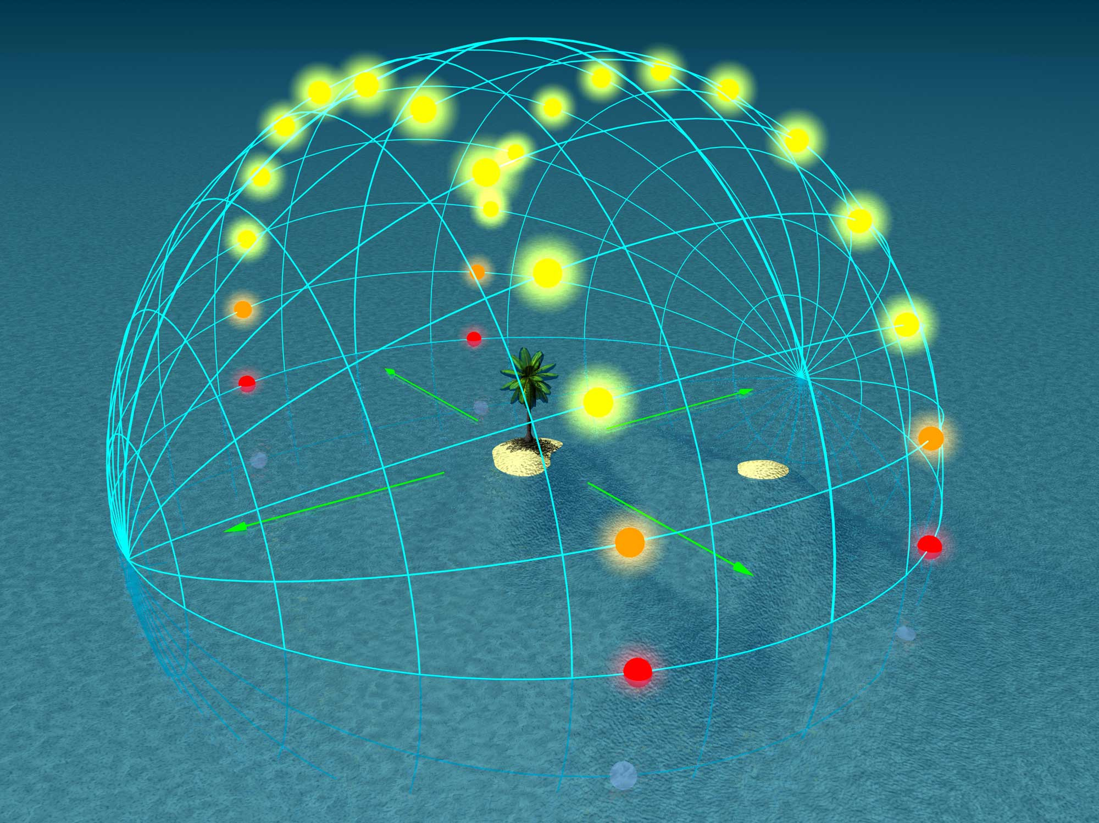
Solar Noon
Solar Noon: The solar Azimuth angle is at 180⁰ (or true South)
  The sun will be at the highest altitude angle for that day.
  This time is called Solar Noon.
Irradiance is at its highest point at Solar Noon.
Tauʻolunga [CC BY-SA 2.5]. Retrieved from https://commons.wikimedia.org/wiki/File:Solstice-0.jpg

Slide 14
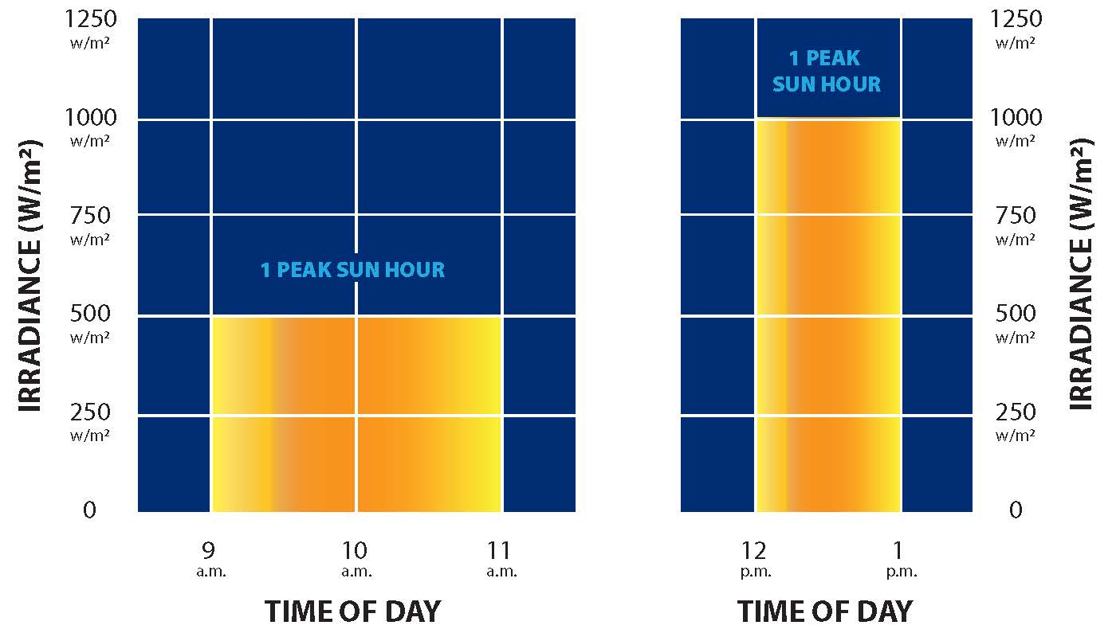
Peak sun hours
Peak sun hours are a measurement of insolation.
One peak sun hour is the equivalent amount of time during which irradiance averages 1000 Watts per meter squared (W/m²).
Northeast Iowa Community College (CC BY 4.0).

Slide 15
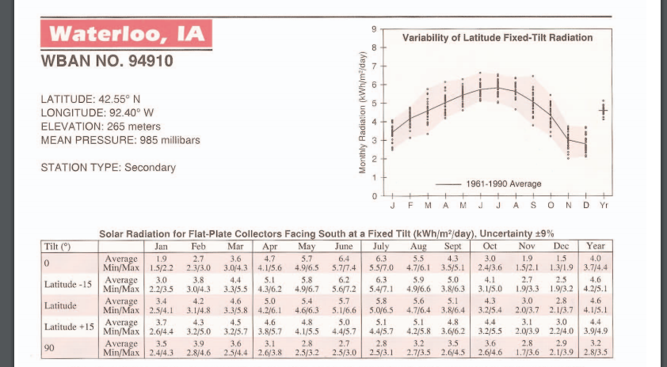
Iowa peak sun hours
Peak sun hours are measured in a monthly or yearly average.
At latitude (42.55) for Waterloo, the June average is 5.7 and the yearly is 4.6.
The National Renewable Energy Laboratory. Solar Radiation Data Manual for Flat-Plate and Concentrating Collectors [Public Domain]. Retrieved from https://rredc.nrel.gov/solar/pubs/redbook/PDFs/IA.PDF

Slide 16
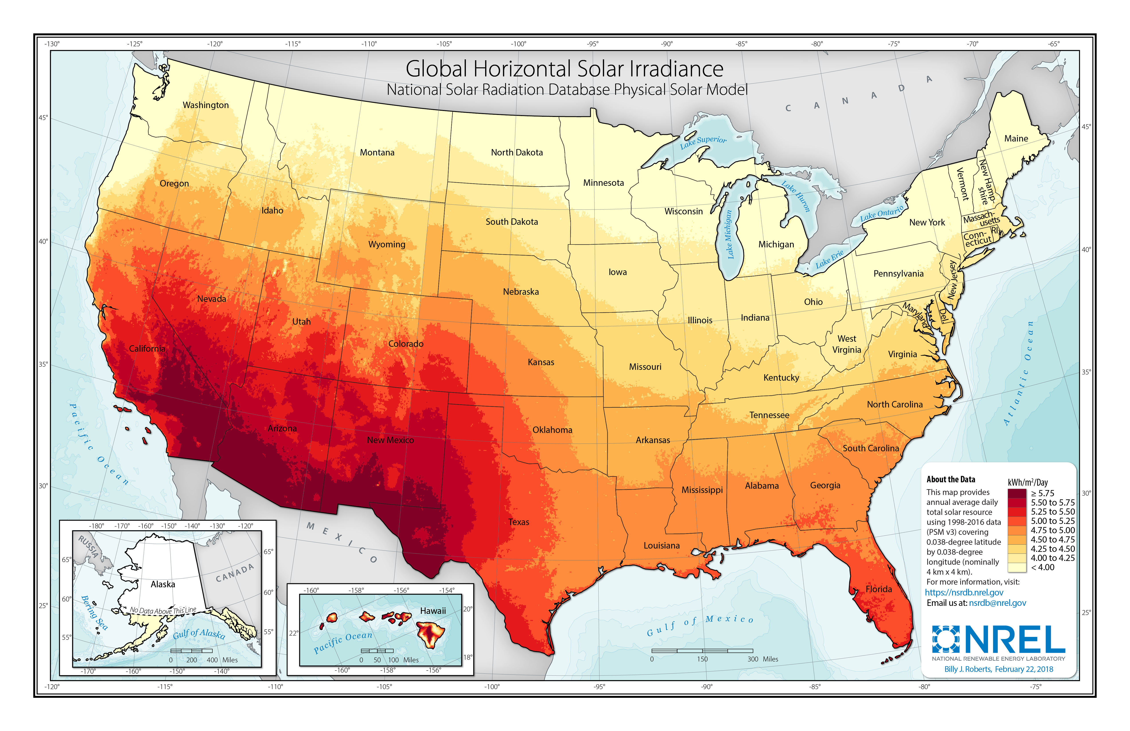
Solar window
Solar window: The timeframe during which a solar system is shade- free.
  A site with an open window from sunrise to sunset would have 100% of potential solar resource available.
  An open window from 9 am to 3 pm represents the majority of solar resources available. It is important to keep this time as shade-free as possible.
National Renewable Energy Laboratory [Public Domain]. Retrieved from https://www.nrel.gov/gis/images/solar/solar_ghi_2018_usa_scale_01.jpg

Slide 17
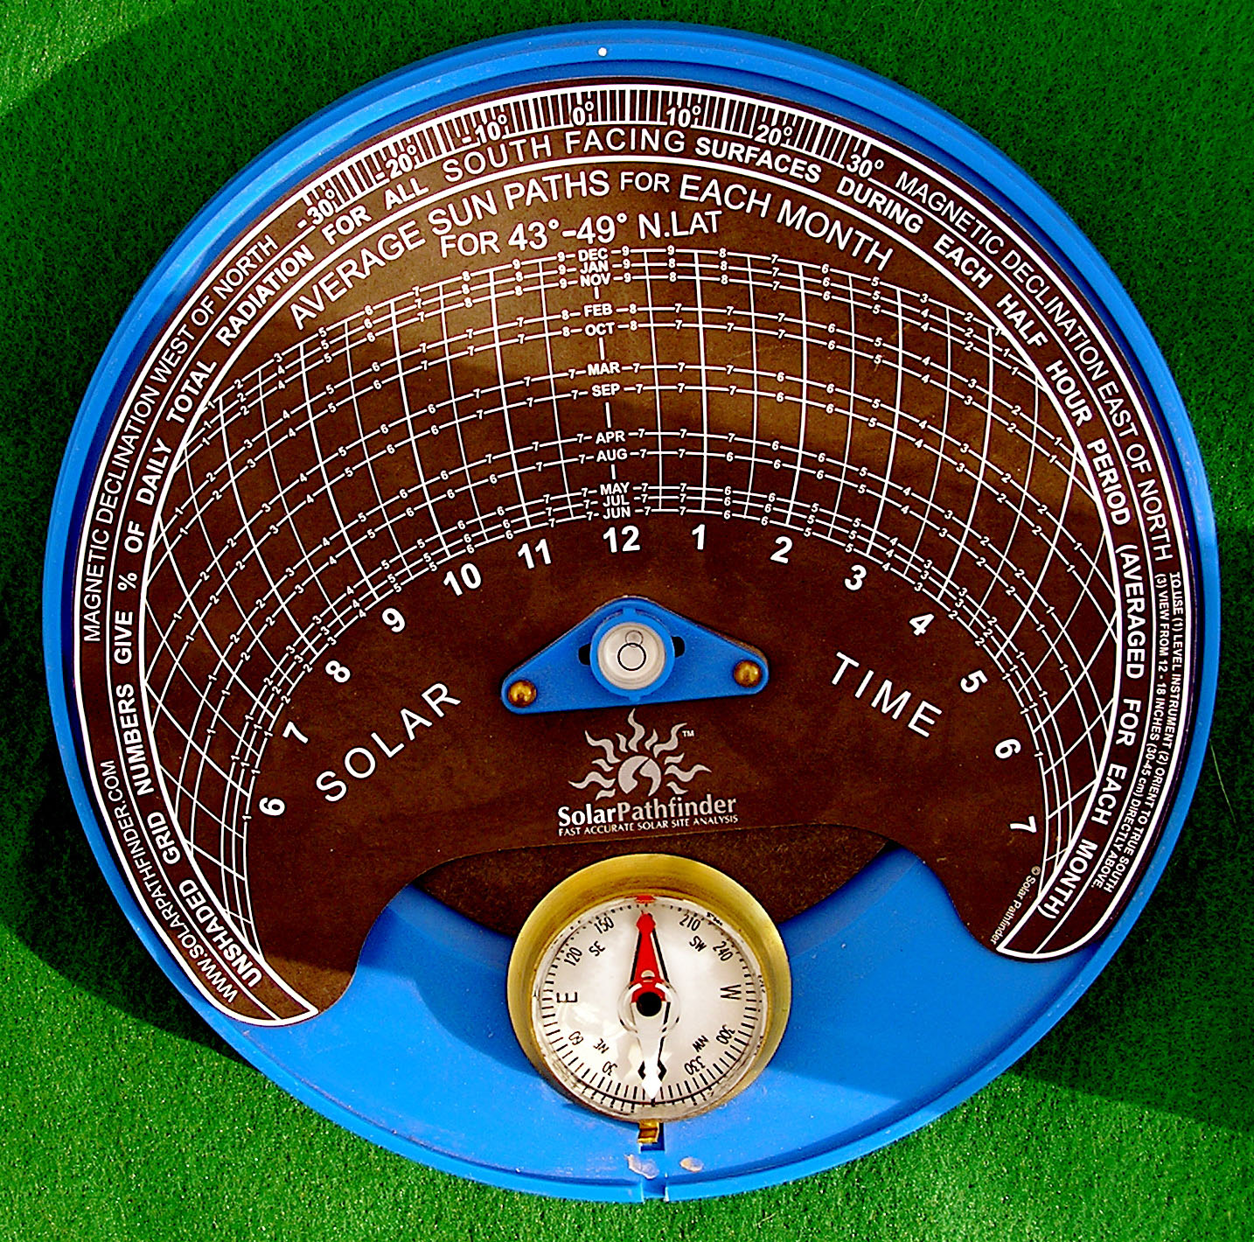
Shading analysis
Shading analysis is needed to be sure the solar window is as shade- free as possible.
A shading analysis can also provide us with information that can tell us how much solar energy we will receive if shading does exist.
https://www.youtube.com/watch?v=DJc4pGwZh-c
Lester Public Library. Solar Pathfinder [CC BY-NC-SA 2.0). Retrieved from https://www.flickr.com/photos/lesterpubliclibrary/2952817713

Slide 18
Conclusion
Upon completion of this unit, students will be able to
Define solar PV
Explain irradiance
Explain insolation
Explain the solar window
Identify peak sun hours
Explain effects of shading
Explain altitude angle
“This presentation was prepared by Northeast Iowa Community College under award EG-17-004 from the Iowa Energy Center. Any opinions, findings, and conclusions or recommendations expressed in this material are those of the author(s) and do not necessarily reflect the views of the Iowa Energy Center.”

