Slide 1

Solar Thermal Basics
Solar thermal basics
Except where otherwise noted these materials
are licensed Creative Commons Attribution 4.0 (CC BY)

Slide 2
Objectives
The objective of this unit is to present the student with some basic terms relating to solar thermal technology. Upon completion, the student will have an understanding of the following:
Insolation
Sun paths
Panel tilt
Direct, indirect and isolated passive solar
Five elements of passive solar design
Active solar

Slide 3
Solar Thermal Energy Defined
Solar Thermal systems produce hot water, not electricity. Possible uses include:
Domestic Hot Water (DHW): Hot water used for sinks, laundry, etc.
Pool Heating: Very economical way to heat a large pool
Space Heating : Supplemental heating for one’s home
Commercial Uses: Heated water for car wash or for cleaning dairy milking machines
Note that solar thermal systems cannot supply 100% of the heated water for homes year round.

Slide 4
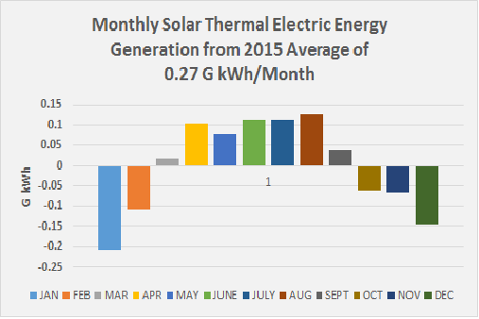
Solar Thermal Electric Energy Generation
Solar thermal panels are more efficient than solar PV panels.
The drawback is that PV systems can be connected to a battery for storage or the grid. A thermal system needs a large area to store excess.
Queenwe [CC BY-SA 4.0]. Retrieved from https://commons.wikimedia.org/wiki/File:2015_Solar_Thermal_Electric_Energy_Generation_Profile.png

Slide 5
Where does solar thermal work?
Solar thermal can be used effectively across the country.
  Directly related to sun hitting the surface
  Based on insolation measured in BTUs/ft2/day
    BTU is defined as the amount of energy necessary to heat one pound of water one degree Fahrenheit.
  Insolation depends on the area of the country where one resides:
          Seattle, WA has one of lowest yearly averages.
          Southern Arizona has one of the highest yearly averages.
Factors affecting insolation
    Cloudiness
      Seattle gets less insolation than Montana or Idaho, and yet they are all at same latitude.
    Sun’s path
      The movement of the sun over one’s house every day.
      The angle of the sun to the earth.
        The sun is lower in the sky during winter months and strikes the earth’s surface at a greater angle, causing less insolation.

Slide 6
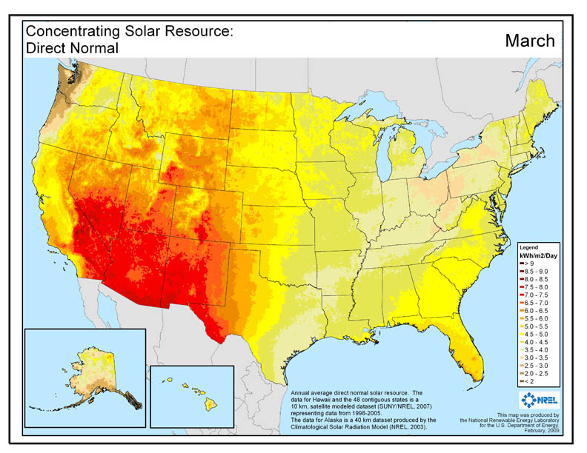
Insolation Map
The National Renewable Energy Laboratory [Public Domain]. Retrieved from https://www.nrel.gov/gis/solar.html

Slide 7
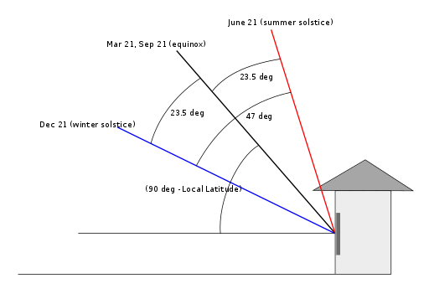
Seasonal Sun Path at 23°N Latitude
The sun is never directly overhead at noon; it is always shining from the south.
Solar panels produce the most energy when pointed at the sun.
Panels should be south-facing.
Panels are forgiving if faced between southeast and southwest. 90% of the sun’s power is available.
Hartz [CC BY-SA 3.0]. Retrieved from https://upload.wikimedia.org/wikipedia/commons/thumb/1/16/Solar_altitude.svg/512px-Solar_altitude.svg.png

Slide 8
Panel Tilt
Latitude lines are horizontal rings around the earth parallel to the equator.
  Elkader, Iowa—latitude 42.8°N
  Kansas City, Kansas—latitude 39.09°N
  Austin, Texas—latitude 30.2°N
If you tilt the panels steeper than the location’s latitude, it will increase the panel’s output in the late fall, winter, and early spring.
If the panels are mounted at a flatter angle than the location’s latitude, the panels will produce more efficiently in the summer months.
Iowa Energy Center. Solar PV Energy Guide. Retrieved from https://www.iowaeconomicdevelopment.com/userdocs/programs/15302_IEC_SolarEnergyGuide_Web.pdf

Slide 9
Passive Solar Thermal
Passive solar energy is a means of harnessing the natural light and heat energy produced by the sun, with no other input of energy.
Three possible methods of passive solar include:
  Direct gain
          Uses south-facing windows
          Greenhouses have incorporated this idea for centuries.
    Indirect gain
          Uses a trombe wall
          This is a dark-colored masonry wall inside the windows to absorb radiation.
  Isolated gain
          Uses a sunroom
          Incorporates heat-absorbing materials in a room

Slide 10
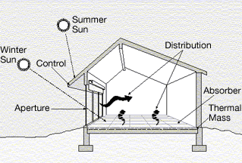
Passive Solar Thermal
The angle of the winter sun is used to reach into the house.
United States Department of Energy [Public domain]. Retrieved from https://commons.wikimedia.org/wiki/File:Illust_passive_solar_d1.gif

Slide 11
Active Solar Thermal
Active solar thermal is the use of a collection device that absorbs the sun’s heat energy, which is then transferred to a medium for use by a pump or fan.
There are two types of active solar:
  Direct Circulation
          Involves the circulation of water or air directly into the solar collector where it is then transferred to the required medium.
          Useful in areas that do not experience freezing temperatures
  Indirect Circulation
          Uses a closed system that transfers heat into a storage tank
          Prevents the unwanted cooling of the heat transfer fluid
          Can be temperature-controlled

Slide 12
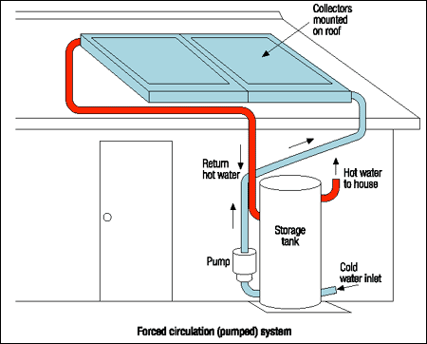
Active Solar Thermal Direct Circulation
SEDO [Public domain]. Retrieved from https://commons.wikimedia.org/wiki/File:Active_open_loop_solar_HW_system.png
Conduction and convection is occurring in the tank.

Slide 13
Conclusion
Upon completion of this unit, students should be able to
Define insolation
Understand how insolation is affected
Distinguish among the seasonal sun paths
Understand the tilt angle
Understand how passive and active solar differ
Define direct and indirect terminology pertaining to solar thermal
“This presentation was prepared by Northeast Iowa Community College under award EG-17-004 from the Iowa Energy Center. Any opinions, findings, and conclusions or recommendations expressed in this material are those of the author(s) and do not necessarily reflect the views of the Iowa Energy Center.”

