Slide 1

Fundamentals of Energy
Heat transfer and efficiency
Except where otherwise noted these materials
are licensed Creative Commons Attribution 4.0 (CC BY)

Slide 2
Objectives
The objective of this unit is to present the student with some basic terms relating to energy, efficiency, and conservation. Upon completion, the student will have an understanding of the following:
Efficiency and Conservation
Energy: Potential and Kinetic
First and Second Law of Thermodynamics
Temperature, Latent and Sensible Heat
Conduction, Convection, and Radiation

Slide 3
Fundamentals of Energy
Responsible energy use is future dependent on a couple of different premises.
Energy Efficiency: Focuses on maximizing any economic benefits by proper energy management.
        Efficiency results in savings
        Example: An Energy Star rating on a piece of equipment
Energy Conservation: This is the focus on Renewable Energies with the emphasis on reducing the use of non-renewable sources.
        Topic of conversation for many years
        Americans are using energy at an unsustainable rate.
        Requires an attitude change by users

Slide 4
Benefits of Efficiency & Conservation
Efficiency of Use: An efficient home will provide more comfort and a maximum value of energy use.
Energy Security: Generating less waste will allow an individual to become less dependent on energy and less vulnerable to higher prices.
Preservation of the Environment: Wasting fewer resources will lead to less damage to the environment.
Sustainability: By generating less waste and shifting toward renewables, we will preserve fossil fuels for future generations, allowing for more diversity.

Slide 5
Use of Renewable Energy
To understand the use of renewable, a person needs to understand efficiency and conservation, in other words—energy education.
  Households next to each other can require very different uses.
  Many different variables affect efficiency.
To understand energy in the home, a homeowner must:
  Understand how heat flows
  Understand how comfort in the home occurs
  Understand the differences in lighting and appliances
  Understand health and safety of the home and occupants
  Understand an energy bill

Slide 6
Energy Overview
Energy is a measurable quantity of heat, work, or light.
Potential Energy: Energy that is stored like a cord of wood, a gallon of gasoline or a ton of coal, or geothermal heat source in the earth
Kinetic Energy: Energy that is transitional like a flame or the energy extracted from the wind by a wind turbine
Measured in different units
  Calorie: The amount of energy it takes to raise the temperature of 1 gram of water by 1° Celsius (C)
  Joule: One calorie is equal to 4.184 joules.
  British Thermal Unit (BTU): The amount of heat required to raise one pound of water 1° Fahrenheit (F). A kitchen match is about 1 BTU of heat.
  kWh: kilo watt-hour

Slide 7
Laws of Thermodynamics
The First Law of Thermodynamics:
  Energy can neither be created nor destroyed; it simply moves from one place to another and changes form.
    The potential energy from gasoline becomes the automobile’s movement.
    The kinetic energy from the wind becomes electricity.
The Second Law of Thermodynamics:
  Heat moves from higher temperature regions to lower temperature regions and never the reverse unless additional energy from an outside source is applied.
    The heated water or air from a home’s heating system transfers heat to the air for comfort.
    The heated water from a solar thermal or geothermal heat source heats domestic water.

Slide 8
Temperature
Describes how hot or cold something is
It is a measure of how fast molecules are moving or vibrating in a substance.
Molecules in a solid are stationary but vibrate faster as heat is added.
Heat flows because of a temperature difference between two points.
Different geographic regions are characterized by the amount of heating and cooling they need.
  Heating Degree Days (HDD) is a measure of how cold a location is over a period of time relative to a base temperature, most commonly specified as 65° F.
  Cooling Degree Days (CDD) is a measure of how warm a location is over a period of time relative to a base temperature, most commonly specified as 65° F.

Slide 9
Understanding Types of Heat
The relationship between water’s temperature and heat content is predictable.
  This will allow us to calculate need or BTU’s.
  Heat will always seek an equilibrium.
Enthalpy: Heat content of substance
  The temperature of a given weight of material tells us how much energy that material contains.
Sensible Heat
  Heat that can be felt
  Example: The temperature of a substance goes from 40°F to 45°F.
Latent Heat
  Hidden heat or a change of state
  Example: Ice at 32°F will become a water ice mixture and remain at 32°F until all the ice is melted.

Slide 10
Understanding how heat travels
Heat travels from a high temperature to a lower temperature in three ways:
Conduction
Heat flow in solids
Convection
Heat flow in fluids
Radiation
Heat flow in a line of sight between bodies

Slide 11
Conduction and understanding the R-value
Conduction
  Heat conducted through solid objects touching one another.
  Metal and glass are good conductors.
  Wood and plastics are poor conductors.
  House insulation is a poor conductor.
  Example of Conduction: Picking up a hot frying pan will conduct heat in one’s hand.
R-value
  A measurement of conduction in reference to a building material’s resistance to heat flow
  R-values are calculated for a given thickness of material; in a wall, the R-values will add up.
  Measured in BTU’s per hour per degree Fahrenheit

Slide 12
Convection
Convection
  Heat transferred by a moving fluid like air or water
  Convection occurs when a portion of a fluid moves because of temperature and density differences.
    Density: Measures how many pounds a cubic foot of a fluid weighs
    Warmer fluid with lower density will tend to rise while denser cooler fluid falls.
  Natural Convection Example: With a radiator in one’s house, the air from the room passes over the surface and heats the air in the room.
  Forced Convection Example: The furnace in one’s house uses a fan to blow air across the heating portion of the furnace, transferring the heat to the air.

Slide 13
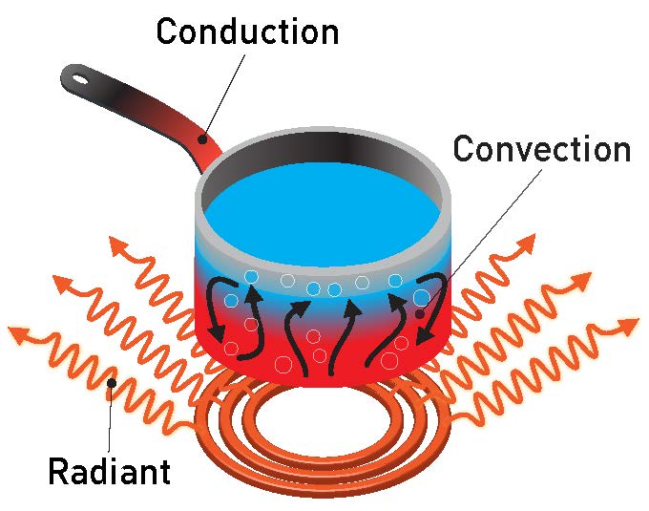
Radiation
Radiation
  Moves through space from one object to another
  As dictated by the second law of thermodynamics, heat flow will move from the higher temperature object to the lower temperature object.
  Objects within the line of sight of each other exchange heat radiation.
Two important types of thermal radiation in regards to heat transfer
  Solar Energy
  Infrared
Nuclear Regulatory Commission from US [CC BY 2.0]. Retrieved from https://commons.wikimedia.org/wiki/File:Heat_Radiation_Transparent_2_(26046216082).jpg

Slide 14
Conclusions
Upon completion of this unit, students should be able to
Efficiency can be defined as the ratio of what we put into a system compared to what we get out.
A latent change is a change of state and cannot be felt; however, a sensible change can be felt.
Energy can be transformed, and it is never lost. Heat, a form of energy, can be considered a loss in a mechanical system.
Everyone experiences heat transfer in some manner.
For comfort, we transfer heat from where it is not wanted to a place where it is unobjectionable.
Degree days is a concept that will allow an individual the ability to predict heating or cooling needs, which we will be able to relate to efficiency.
In order to preserve the earth, the focus needs to be on the conservation of resources.
Energy education is the responsibility of everyone.
“This presentation was prepared by Northeast Iowa Community College under award EG-17-004 from the Iowa Energy Center. Any opinions, findings, and conclusions or recommendations expressed in this material are those of the author(s) and do not necessarily reflect the views of the Iowa Energy Center.”

