Slide 1
Solar Thermal Basics
collectors, operation and layout
Except where otherwise noted these materials are licensed Creative Commons Attribution 4.0 (CC BY)

Slide 2
Objectives
The objective of this unit is to present the student with information on basic collectors and some common basic systems. Upon completion, the student will have an understanding of the following:
Different Collectors
Drain back systems
Close loop pressurized systems
The integration of solar components into a system

Slide 3
Collectors
The collectors at the basic level are just black tubes carrying water that will absorb heat.
Radiation heating occurs when waves of light from the sun are absorbed by a surface; this is the basis for solar thermal panels.
Radiation heating is what an individual would experience standing in front of a campfire.
In all heat transfer, energy is taken from the hotter object that gets cooler and given to the cooler object that gets hotter.

Slide 4
Collectors
Absorber plates: A black surface will heat up faster than a white surface due to absorptivity, which means the surface absorbs a greater percentage of the light waves.
Flat Plate and Evacuated tubes collectors use absorber plates.
Glass covers: Flat plate and evacuated tubes use a surface layer of glass to shield from wind and contain the greenhouse effect in the collector.
Insulation: Insulation is very important and needs to be effective. It will prevent heat loss on cold sunny days or when the heat transfer fluid is very hot on warm days.
Four common collectors for small scale installation include:
Un-Glazed Flat Plate
Glazed flat plate
Evacuated Tube
Concentrating

Slide 5
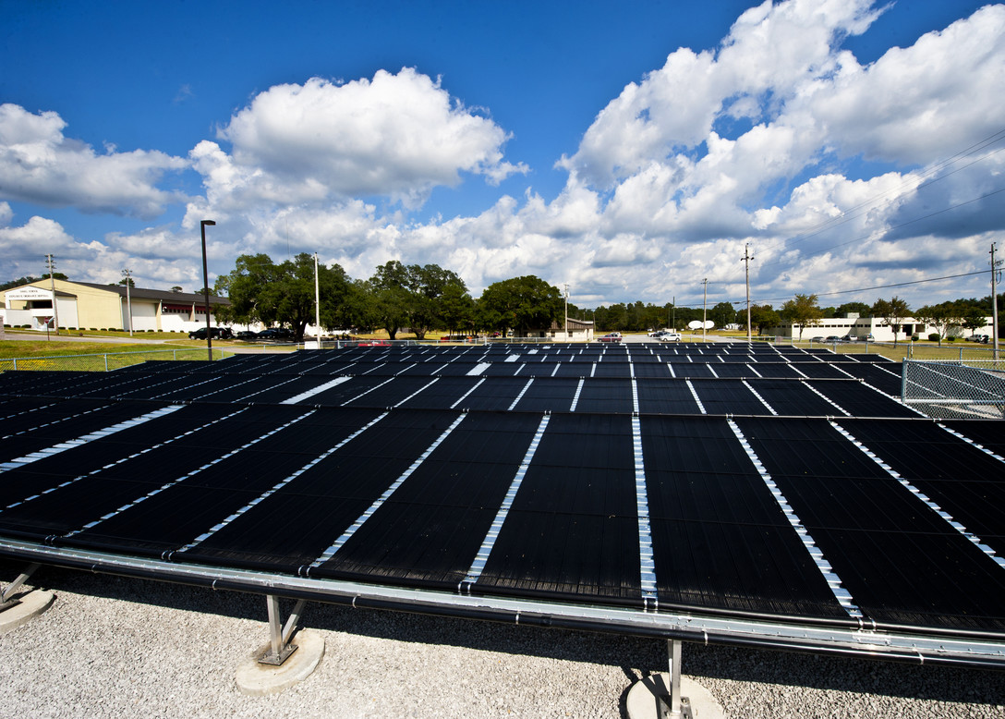
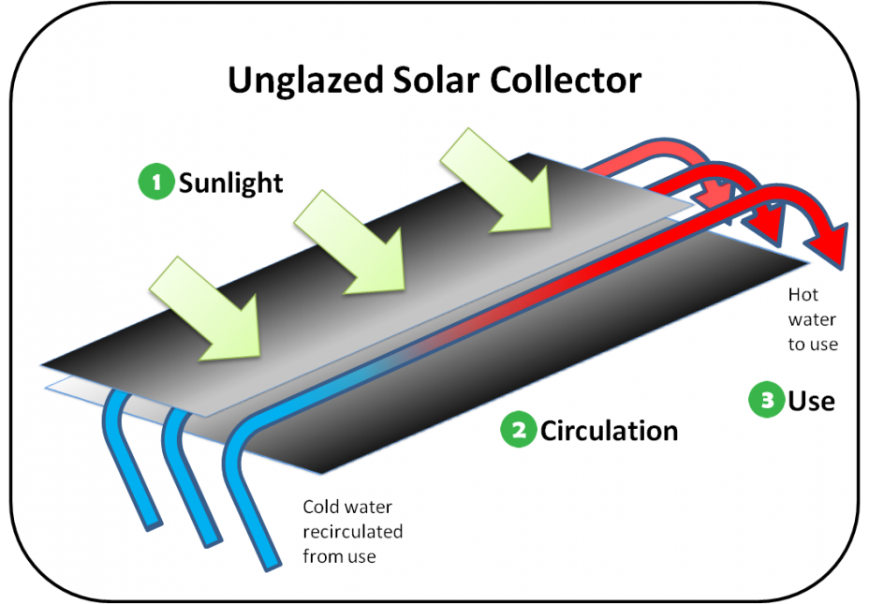
Un-Glazed Flat Plate Collector
Simplest and least expensive collectors
No insulation, absorber plates or glazing
Inefficient
When the water inside the system becomes hotter than the outside air, the system transfers heat out of system.
Mainly used for heating pools in summertime
Samuel King Jr. U.S. Air Force [Public Domain]. Retrieved from https://www.eglin.af.mil/News/Photos/igphoto/2000209325/
Environmental Protection Agency [Public Domain]. Retrieved from https://www.epa.gov/rhc/solar-heating-and-cooling-technologies

Slide 6
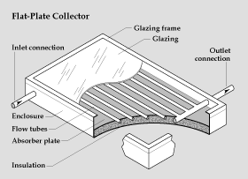
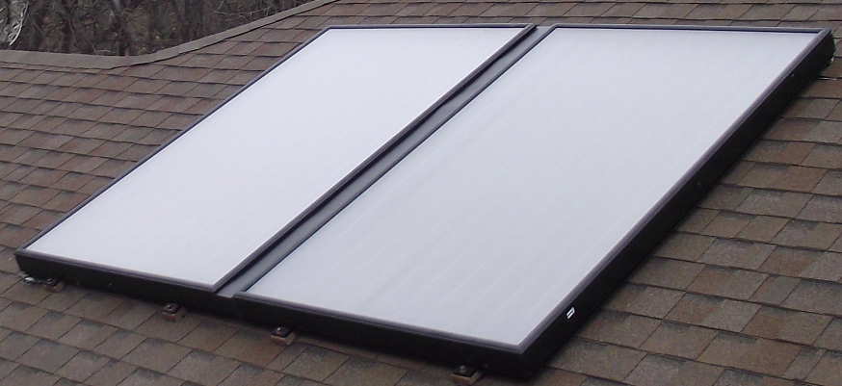
Glazed Flat Plate Collector
Simple in design
Inexpensive in cost in terms of BTU collected per square foot
The tubes carry fluid and are fused to an absorber plate.
Insulated frame
Insulated tempered glass creates a greenhouse effect holding heat in.
SolarCoordinates [CC BY-SA 3.0]. Retrieved from https://commons.wikimedia.org/wiki/File:Flatplate.png
EERE [Public domain]. Retrieved from https://commons.wikimedia.org/wiki/File:Flat_plate_glazed_collector.gif

Slide 7
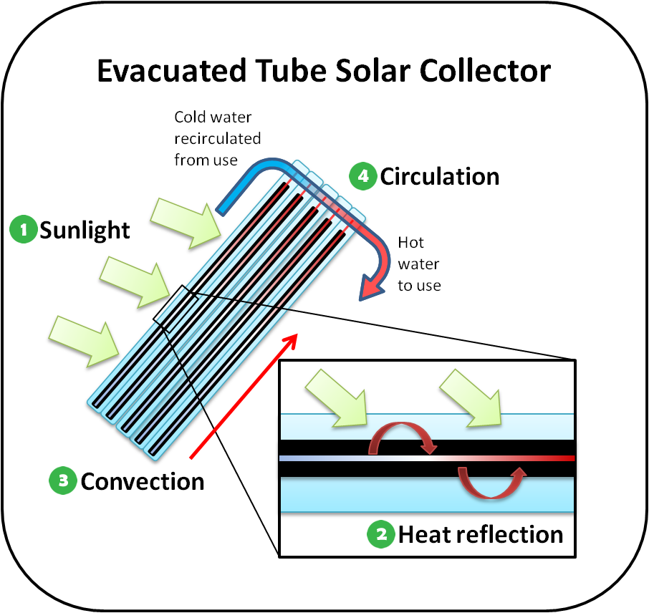
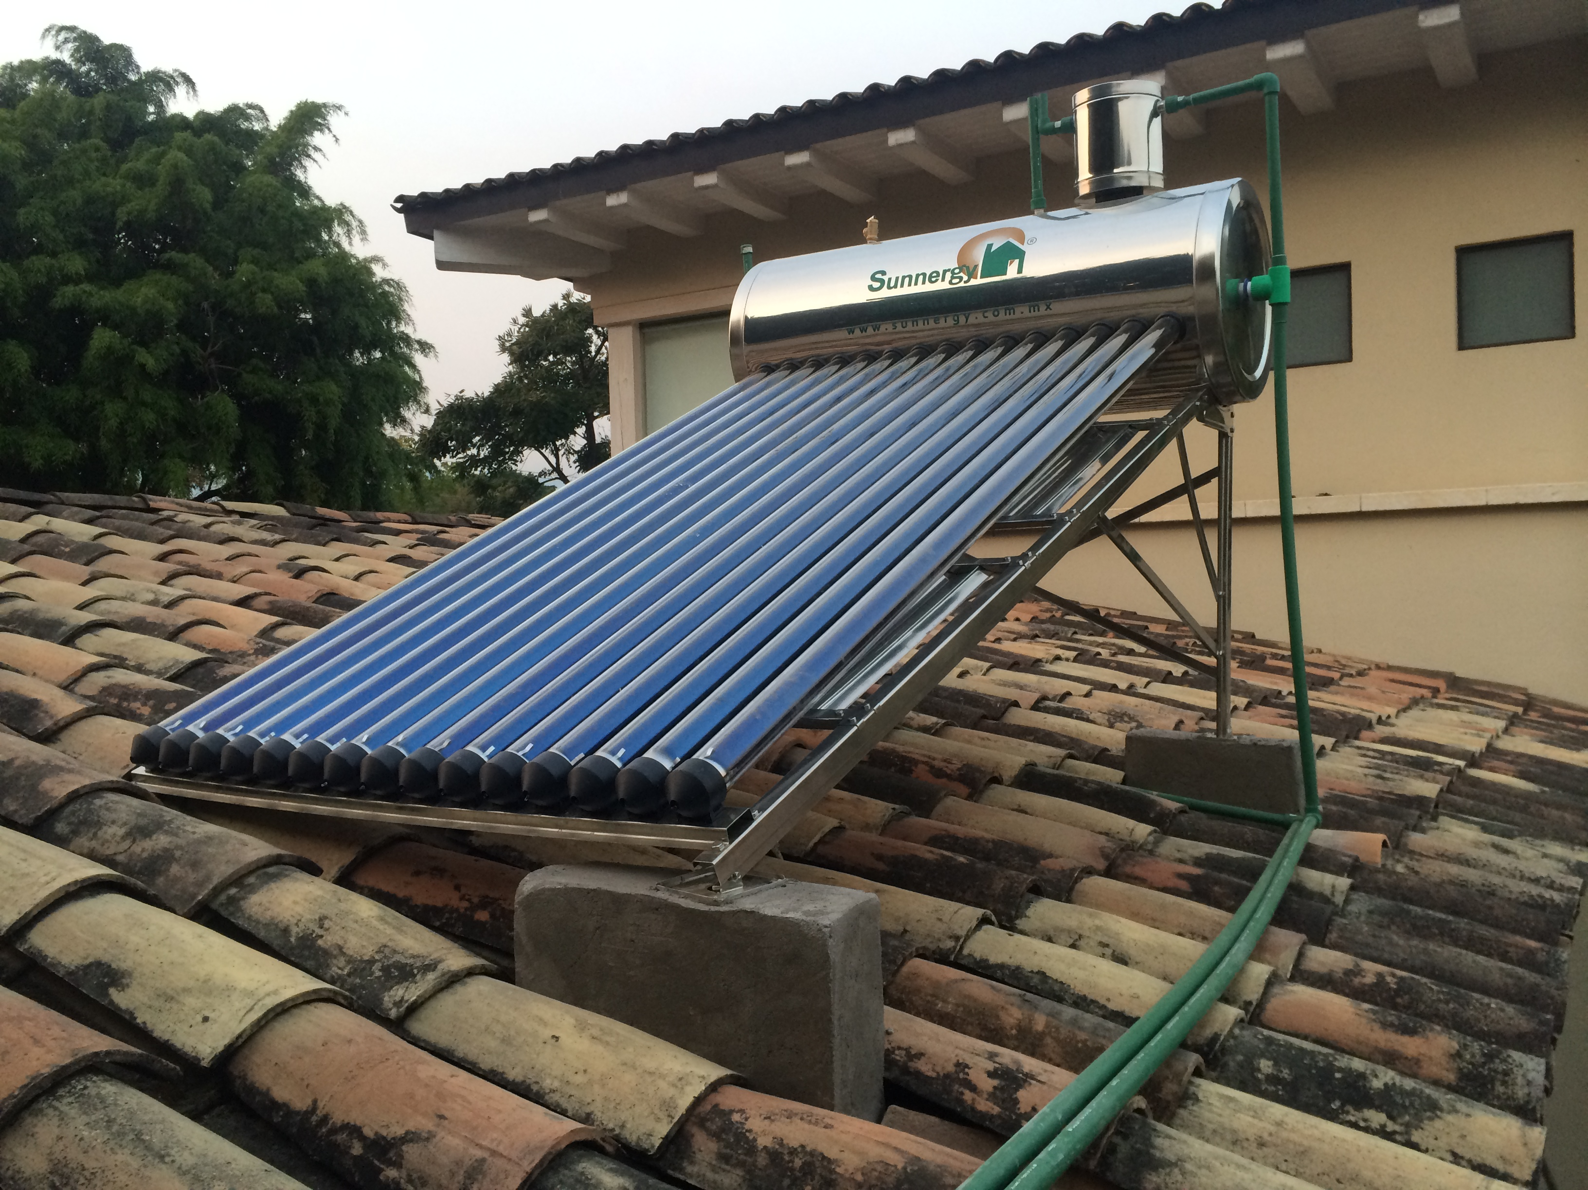
Evacuated Tube Collector
They are more complicated than flat plate collectors; however, they offer many advantages.
They do not use insulation but create insulation by removing the air from inside the glass. (Vacuum)
A vacuum is a very good insulator since there are fewer air molecules to transfer heat by conduction or convection to the outer wall of the tube.
Tubes will be cool to the touch on a hot day.
Mmz.alonso [CC BY-SA 4.0]. Retrieved from https://commons.wikimedia.org/wiki/File:Sistema_por_Hidroneumatico_(Calentador_solar_para_alta_presi%C3%B3n).JPG
Environmental Protection Agency [Public Domain]. Retrieved from https://www.epa.gov/rhc/solar-heating-and-cooling-technologies#Evacuated-tube-solar-collectors

Slide 8
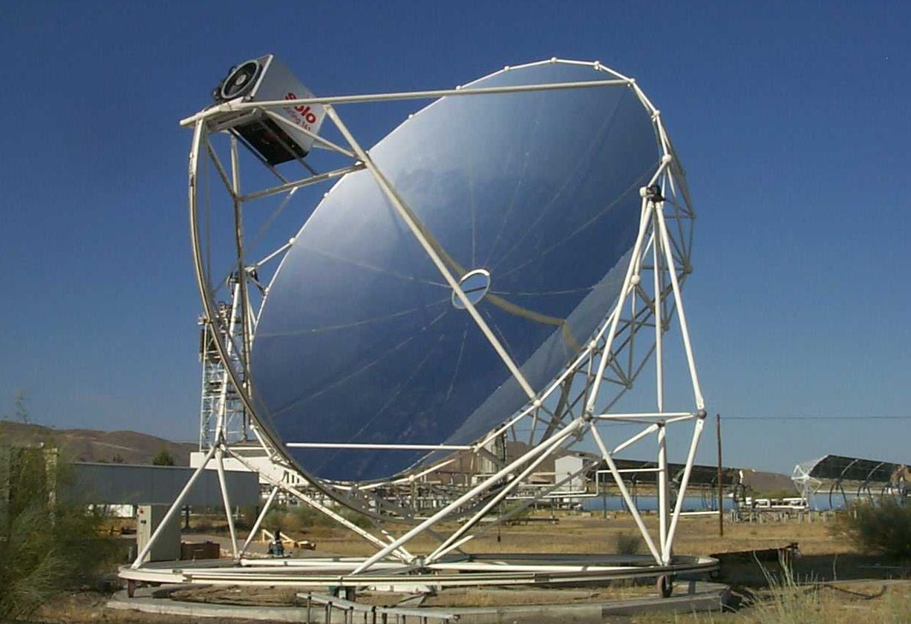
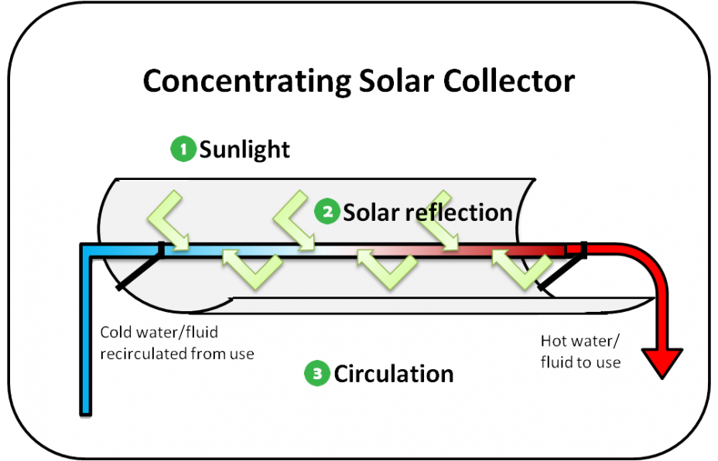
Concentrating Collectors
Works on the same premise of starting a fire with a magnifying glass.
Mirrors focus the sunlight to a central point.
A parabolic configuration of mirrors direct the sun to an uninsulated tube carrying heat transfer fluid.
A very simplistic tracking sun tracking system which make it more efficient.
Schlaich Bergermann [Public Domain]. Retrieved from https://commons.wikimedia.org/wiki/File:EuroDishSBP_front.jpg
Environmental Protection Agency [Public Domain]. Retrieved from https://www.epa.gov/rhc/solar-heating-and-cooling-technologies#Concentrating-solar-systems

Slide 9
Drain Back Systems
One of the most trouble-free systems used in solar thermal
No antifreeze is needed in the system.
No heat transfer fluid pressure is needed.
No air scoops or vents are needed.
Fail safe - This is a critical concept of any system.
The piping is configured to run out of the array: water runs downhill, a minimum of 10 degrees to allow the bubbles to travel up the pipe.
Very simple maintenance is required.

Slide 10
Drain Back System Operation
The pump moves fluid up to the array to absorb energy from the sun.
The heat absorbed is transported to a heat exchanger to be transferred to DHW or space heating.
The controller will monitor all points to determine actions.
Solar array temperature
Store temperature
The controller will make determinations as to turn pump on or off.
If it gets close to a freezing point (38°F), pump will go off.
When the pump shuts off, the fluid will drain back because of gravity.
The collector chosen must be a draining style collector and the collectors need to be pitched.
Grid style collectors

Slide 11
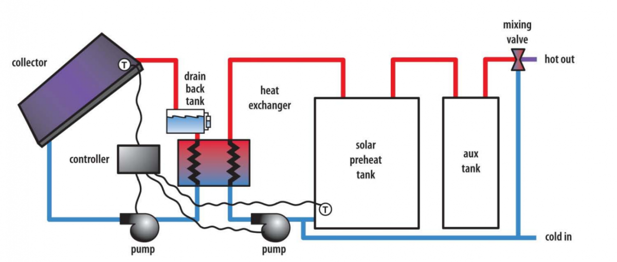
Drain Back with Controller
U.S. Department of Energy [Public Domain]. Retrieved from https://basc.pnnl.gov/resource-guides/drain-back-%E2%80%93-solar-hot-water#quicktabs-guides=1

Slide 12
Closed Loop Glycol Based
Closed loop glycol systems are the most widely installed solar thermal systems in use today.
Reliable operation in all climates if installed properly
Typically installed in freezing climates
Use polypropylene/water glycol mixtures.
Heat exchangers transfer heat from solar loop into storage tank or directly into load.
Since the solar loop contains glycol, it must be indirect or closed, meaning the heat transfer fluid never mixes with DHW.
By maintaining a separate solar loop, we can control both the GPM and pressure.
Can utilize internal or external heat exchangers for transfer

Slide 13
Operation of Closed Loop Glycol-Based
The pumps move fluid through the solar loop and heating or DHW loop, transferring heat between systems-based heat transfer and thermodynamic principles.
The controller will monitor the panel temperature, store temperature and cycle pumps on and off, depending on demand.
Depending on the type of system, the solar fluid may or may not remain in the system.

Slide 14
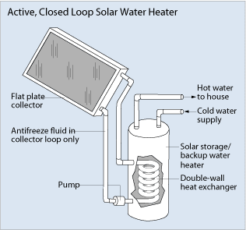
Closed Loop Glycol Based/Internal Heat Exchanger
EERE [Public domain]. Retrieved from https://commons.wikimedia.org/wiki/File:Active_closed_loop_solar_HW_system.png

Slide 15
Conclusions
Upon completion of this unit, students should be able to
Define different collectors
Compare different collectors
Explain a drain back system and how it operates
Explain a closed loop pressurized system and how it operates
Explain the purpose of the electronic controller
“This presentation was prepared by Northeast Iowa Community College under award EG-17-004 from the Iowa Energy Center. Any opinions, findings, and conclusions or recommendations expressed in this material are those of the author(s) and do not necessarily reflect the views of the Iowa Energy Center.”

