Slide 1
Components
Cells, Modules and arrays
Except where otherwise noted these materials are licensed Creative Commons Attribution 4.0 (CC BY)

Slide 2
Objectives
The objective of this unit is to present the student with some basic terms relating to solar PV components. Upon completion, the student will have an understanding of the following:
Solar cells
P/N junction
Cell output
Various cell construction
Cell wiring configurations

Slide 3
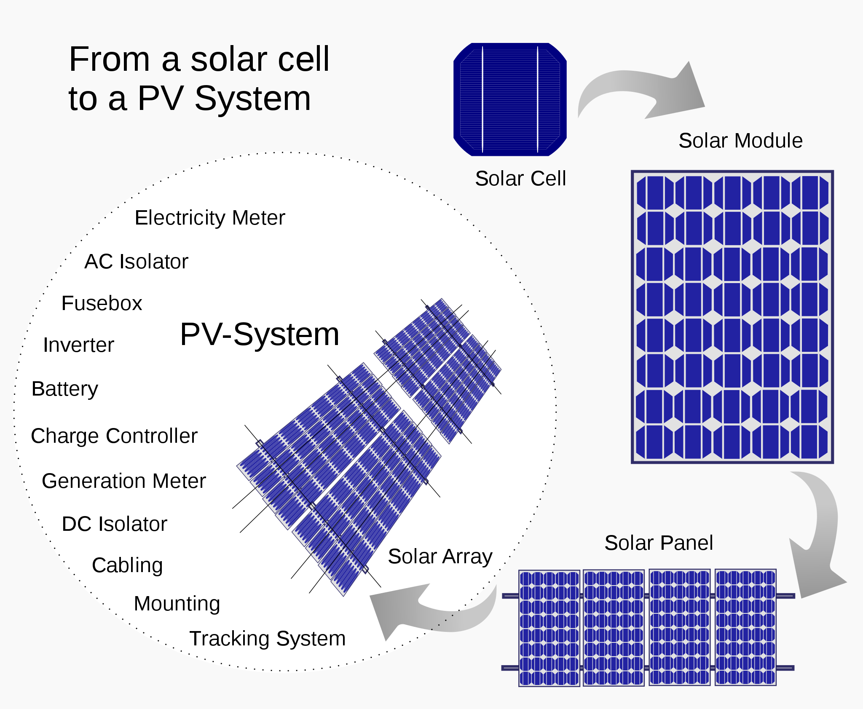
Cells, Modules and arrays
Rfassbind [Public domain]. Retrieved from https://commons.wikimedia.org/wiki/File:From_a_solar_cell_to_a_PV_system.svg

Slide 4
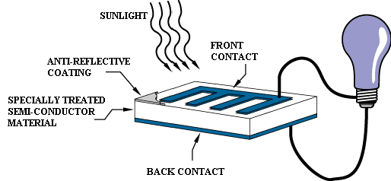
Solar Cell
Solar cells are semiconductor devices that convert sunlight to DC electricity. A solar cell is the basic element of a PV module.
Solar cells are roughly the thickness of a piece of paper .1 mm or 100 micrometers.
They are made out of the same semiconductor as computer chips.
Gil Knier [Public domain]. Retrieved from https://commons.wikimedia.org/wiki/File:Operation_of_a_basic_photovoltaic_cell.gif
Notes:
Solar cells have a Positive and a Negative side just like a battery. One of the original names fro a solar cell was a solar battery. Like a battery, the electrons move in one direction known as direct current (DC). Unlike a battery, the solar cell will only move electrons when exposed to light.

Slide 5
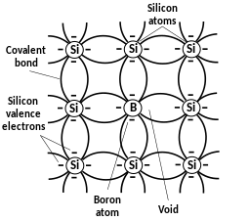
Semiconductor
A semiconductor is a material that consists of the electrical conductivity characteristics between that of a conductor and insulator.
Semiconductors are generally made from silicon or germanium, though silicon is by far the most common element used in semiconductors today.
Silicon makes up 90% of the Earth’s crust, making it the second-most available element in the Earth’s crust.
MichelBakni [CC BY-SA 4.0]. Retrieved from https://commons.wikimedia.org/wiki/File:Silicon_doping_-_Type_P.svg

Slide 6
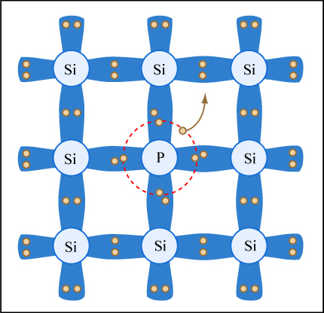
P- Type and N –type Doped silicon
A solar cell converts solar radiation to DC electricity and is the basic building block of PV modules and arrays.
Modern solar cells are created by junctions between different semiconductor materials.
A typical crystalline silicon solar cell is a junction between boron-doped silicon (P-type) and phosphorus-doped silicon (N-type) semiconductors.
N-type semiconductors are materials having excess electron charge carriers.
P-type semiconductors are materials having a deficiency of electron charge carriers or excess electron voids (holes).
Image by MIT OpenCourseWare [CC BY 2.0]. Retrieved from https://www.flickr.com/photos/mitopencourseware/3363321260

Slide 7
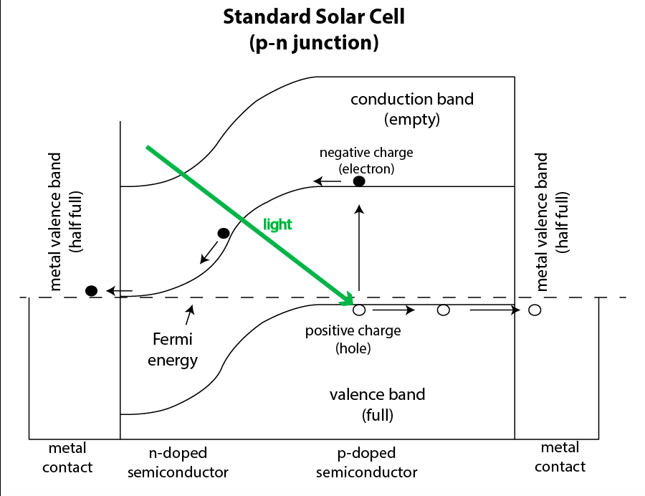
P-N Junction
The interface where P-type silicon and N-type silicon meet is called the P-N junction. It is also known as the depletion region.
At the P-N junction, the electrons fill the holes right next to them and form a gate or block of sorts.
Bhpaak [CC BY-SA 4.0]. Retrieved from https://commons.wikimedia.org/wiki/File:Standard_Solar_Cell.png
Notes:
Since opposite attract, the rest of the electrons would like to get to the positive holes on the other side of the P-N junction, but they cant because the P-N junction is like a light switch turned off. The two types are doped on a single piece of silicon in a manufacturing process.

Slide 8
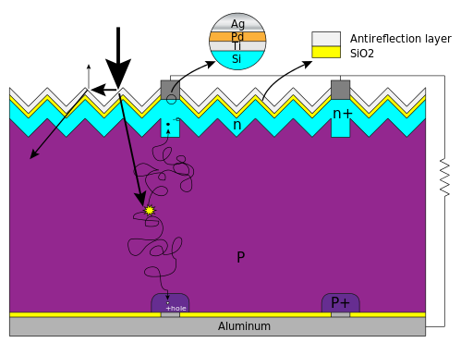
The Photovoltaic Effect
The photovoltaic effect is the process of creating a voltage across charged materials that are exposed to electromagnetic radiation.
Photons from the sun contact the cell and its P-N junction, causing a state imbalance by moving charged particle across the junction.
By adding a conductive circuit and a load to the outside of the cell, it gives the electrons a path for flow to the other side as a means of finding balance.
This is a constant process as long as the sun is shining on the cell.
Cyferz at English Wikipedia [CC BY 3.0]. Retrieved from https://commons.wikimedia.org/wiki/File:Silicon_Solar_cell_structure_and_mechanism.svg
Notes:
This is a constant process as long as the sun is shining on the cell.

Slide 9
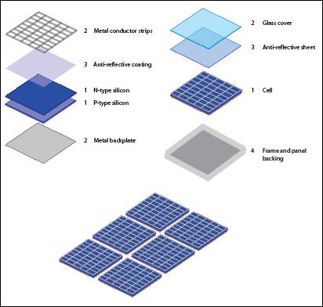
PV Module Construction
After all the solar cells are soldered together in a series, they are placed between two layers of encapsulant also known as EVA (ethylene vinyl acetate).
The front glass must be very low or no iron and must be tempered.
A tough polymer back sheet will protect the back of the cells.
Qmwnebvr97 [CC BY 4.0]. Retrieved from https://en.wikipedia.org/wiki/File:Layers_of_solar_panel.jpg
Notes:
Toughened or tempered glass is a type of safety glass processed by controlled thermal or chemical treatments to increase its strength compared with normal glass. Tempering puts the outer surfaces into compression and the interior into tension. Such stresses cause the glass, when broken, to crumble into small granular chunks instead of splintering into jagged shards as plate glass (a.k.a. annealed glass) does. The granular chunks are less likely to cause injury.

Slide 10
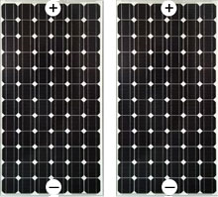
Design for 24 Volt
Adding modules in series, just like with cells, will increase voltage.
VOC or voltage open circuit : When voltage is measured with no load and an open positive and negative.
+ VTOTAL = 24 V
- ITOTAL = 6 AMP
12 volt
6 Amp Modules
Northeast Iowa Community College [CC BY 4.0].
Notes:
Voc is the highes votage a module can have with STC standard test conditions.

Slide 11
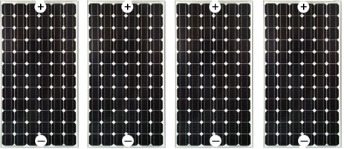
Design for 48 Volt DC
+ VTOTAL = 48 V
- ITOTAL = 6 AMP
12 volt
6 Amp Modules
48V
6 Amp
Northeast Iowa Community College [CC BY 4.0].

Slide 12
String
When two or more modules are connected in series together to reach a certain voltage for a device, this is known as a string.
When a measurement of voltage is taken at the ends of an open circuit for a string, it is still called VOC (voltage open circuit).
State of New York [Public domain]. Retrieved from https://www.nyserda.ny.gov/All-Programs/Programs/NY-Sun/Communities-and-Local-Governments/Solar-Guidebook-for-Local-Governments
Notes:
This can also be called an array.

Slide 13
Design for 12 Volt
Parallel is when the positives leads of modules are tied together and all the negatives leads of modules tied together.
This does not do anything to Voltage but will increase Amps or the current.
+ VTOTAL = 12 V
- ITOTAL = 12 AMP
12 Volt
6 Amp Modules
Northeast Iowa Community College [CC BY 4.0].

Slide 14
Array
An Array: Modules are connected in series to reach a certain Voltage.
Then those strings are connected in parallel to reach a certain amperage.
This will create an ARRAY of how many Watts? (Volts x AMPS = Watts)
+ VTOTAL = 48 VDC
- ITOTAL = 20 AMP
12 volt
10 Amp Modules
Northeast Iowa Community College [CC BY 4.0].
Notes:
960 Watts. Close enough to consider this a One kilowatt array. A piece of equipment like an inverter or charge controller is where this array will feed into. The inverter or charge controller will be a certain wattage in this case 1kW and the volts and amps must fit the input needs. In this case it must be able to handle over the 48 volts due to temperature fluctuation and over 20 amps due to spikes in irradiance. Reflections off clouds plus direct sun light will give more irradiance that the module was tested at, this will cause spikes in irradiance and wiring would need to be adjusted for the higher possible amperage.

Slide 15
Conclusion
Upon completion of this unit, students should be able to
Discuss how cells modules and arrays differ
Explain the P & N junction
Discuss the PV effect
Compare different cells
Explain the different configurations
Explain how to hook-up cells for different outputs
“This presentation was prepared by Northeast Iowa Community College under award EG-17-004 from the Iowa Energy Center. Any opinions, findings, and conclusions or recommendations expressed in this material are those of the author(s) and do not necessarily reflect the views of the Iowa Energy Center.”

