Slide 1

Components
inverters
Except where otherwise noted these materials
are licensed Creative Commons Attribution 4.0 (CC BY)

Slide 2
Objectives
The objective of this unit is to present the student with some basic terms relating to solar components. Upon completion, the student will have an understanding of the following:
Inverter operation
DC and AC sine waves
Types of inverters
Stand alone vs interconnected inverters

Slide 3
Inverters
Inverters are used in PV systems to convert direct current (DC) power from batteries or PV arrays into alternating current (AC) power.
We use far more AC loads on a daily basis than DC loads. Our DC loads usually consist of computers and smart devices that have a charger that plugs into an AC outlet.
Rather than remaking everything to run on DC, we use an inverter to change the DC that PV and batteries produce into AC power output suitable for utilization loads or connection to other electrical systems.
Notes:
Modern electronic inverters used in PV systems are microprocessor-based power conditioning units (PCUs) that convert DC power input from a battery or PV array into AC power output suitable for utilization loads or connection to other electrical systems. Inverters are also used to produce AC power from fuel cells and some wind turbines with DC generators. Large inverters and rectifiers are used for high-voltage DC power transmission across grid interties. Inverters are also an integral part of devices that produce variable or high-frequency output, such as electronic lighting ballasts, induction heaters and variable-frequency drives. Inverters are often used in conjunction with DC-DC converters and other power conditioning equipment components in high speed microturbine generators.
Reference: Photovoltaic Systems, p. 210-211

Slide 4
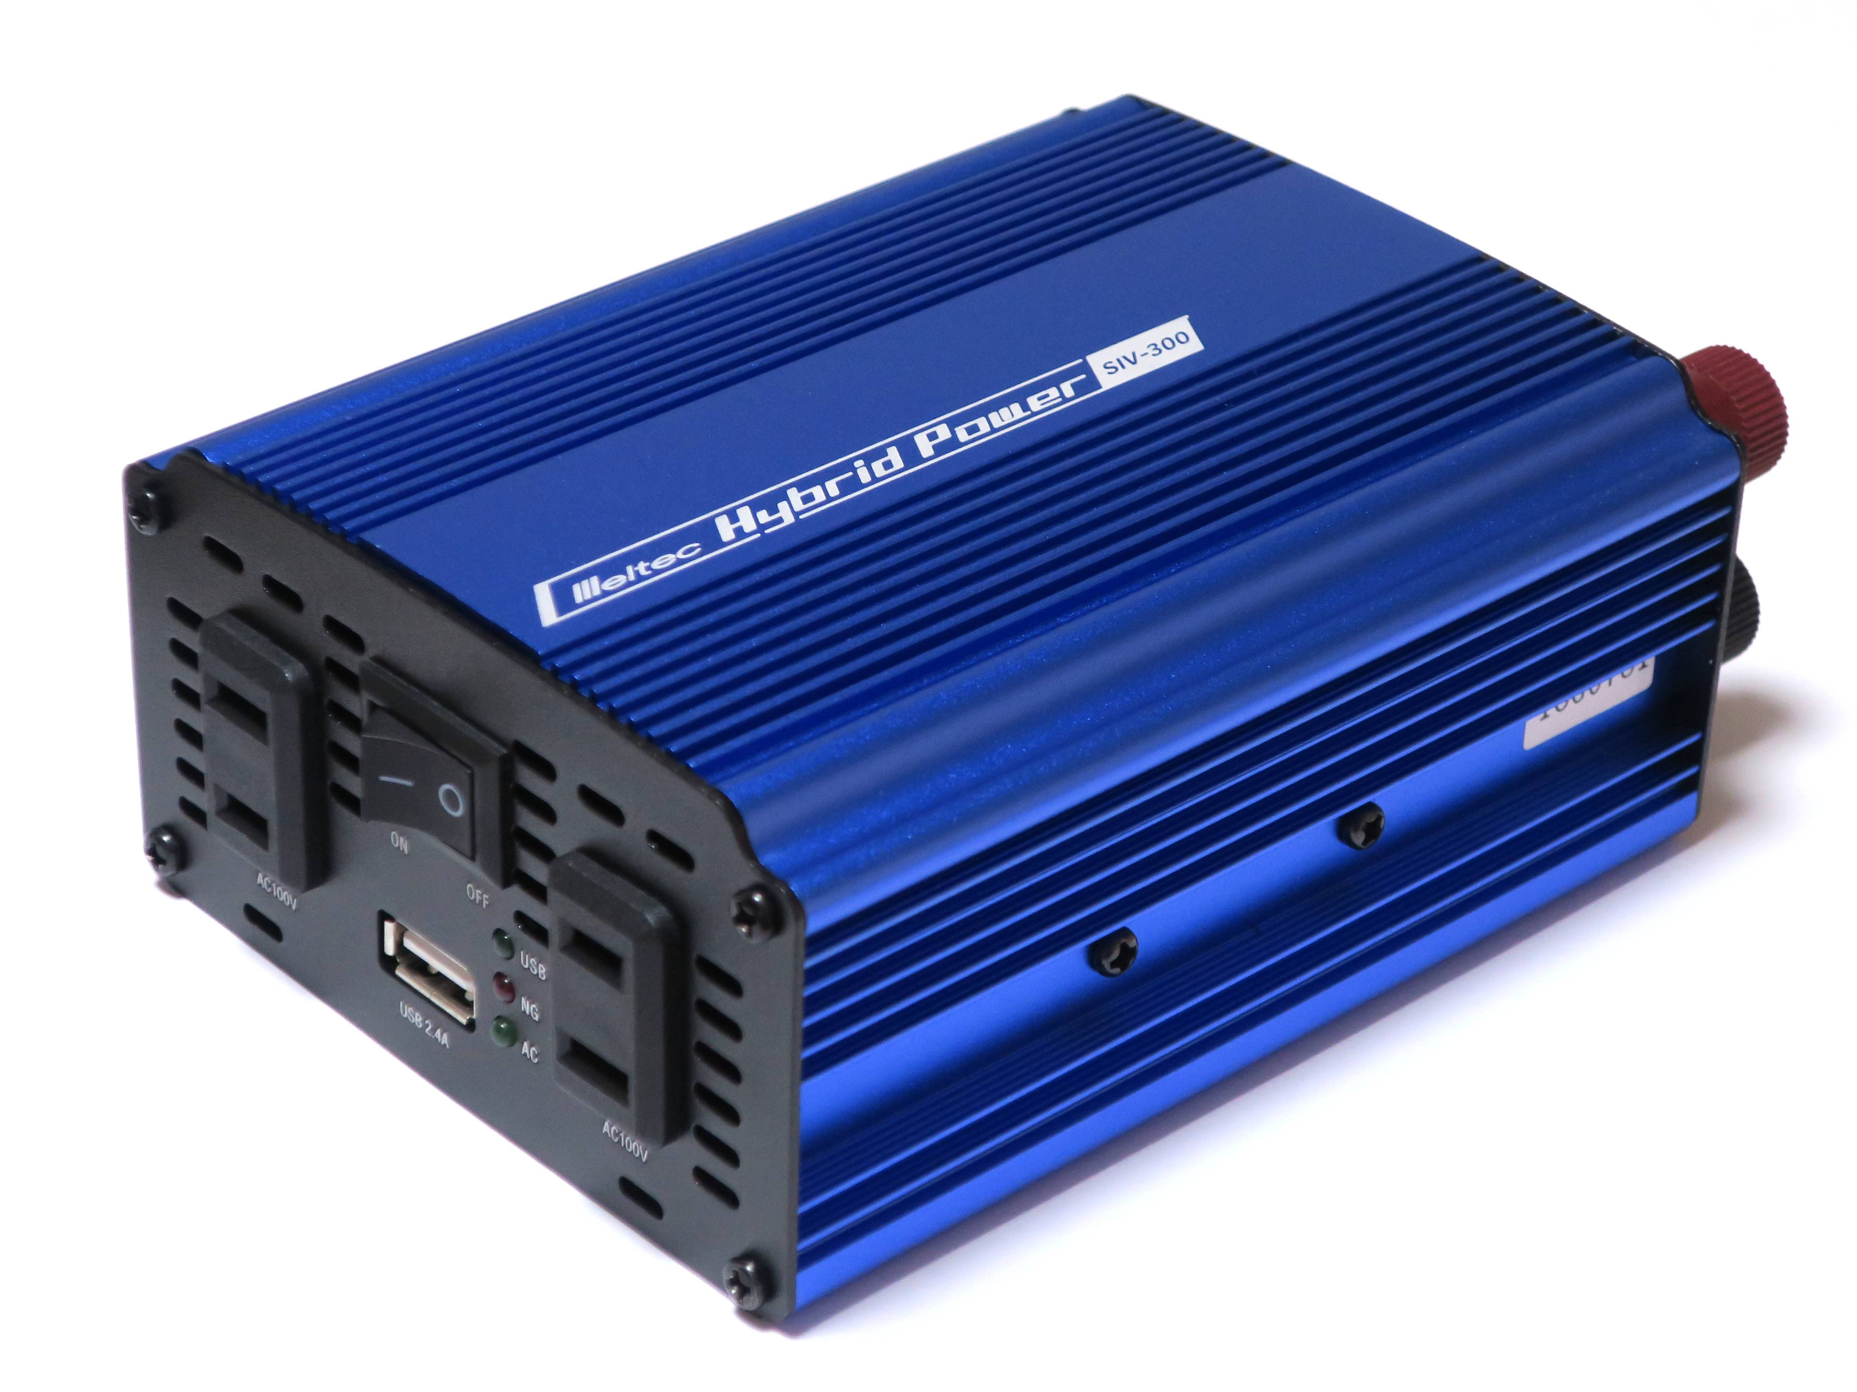
Inverter sizing
Inverters are sized by Watts.
If a house requires 8000 Watts to reach its energy needs, one could use an 8kW inverter or a combination of 2kW or 4kW inverters connected to an 8000 Watt array.
Multiple inverters are thought to be better; in case one breaks down, the others will continue to work.
Array string sizes or voltages are decided by the input voltage labeled on the inverter and whether it is grid tied or off-grid.
Qurren [CC BY-SA 4.0]. Retrieved from https://commons.wikimedia.org/wiki/File:Meltec_car_power_inverter_SIV-300.jpg

Slide 5
Types of PV Inverters
Stand-Alone Inverters
  Operate from batteries and supply power independent of the utility grid.
Utility-Interactive or Grid-Connected Inverters
  Operate from PV arrays and supply power in parallel with the utility grid.
Bi-Modal or Battery-Based Interactive Inverters
  Operate as diversionary charge controllers, and produce AC power output to regulate PV array battery charging when the grid is energized.
  Transfer PV system operation to a stand-alone mode and provide backup electric power to critical loads when the utility grid is not energized .
Notes:
Stand-alone inverters operate from batteries and supply power independent of the electrical utility system. These inverters may also include a battery charger to operate from an independent AC source, such as a generator.
Utility-interactive or grid-connected inverters operate from PV arrays and supply power in parallel with an electrical production and distribution network. They do not supply PV array power to loads during loss of grid voltage (energy storage is required).
Bi-modal inverters are a type of battery-based interactive inverter that act as diversionary charge controllers by producing AC power output to regulate PV array battery charging, and send excess power to the grid when it is energized. During grid outages, these inverters transfer backup loads off-grid, and operate in stand-alone mode. They can operate either in interactive or stand-alone mode, but not simultaneously.
Reference: Photovoltaic Systems, p. 93-94, 212-213

Slide 6
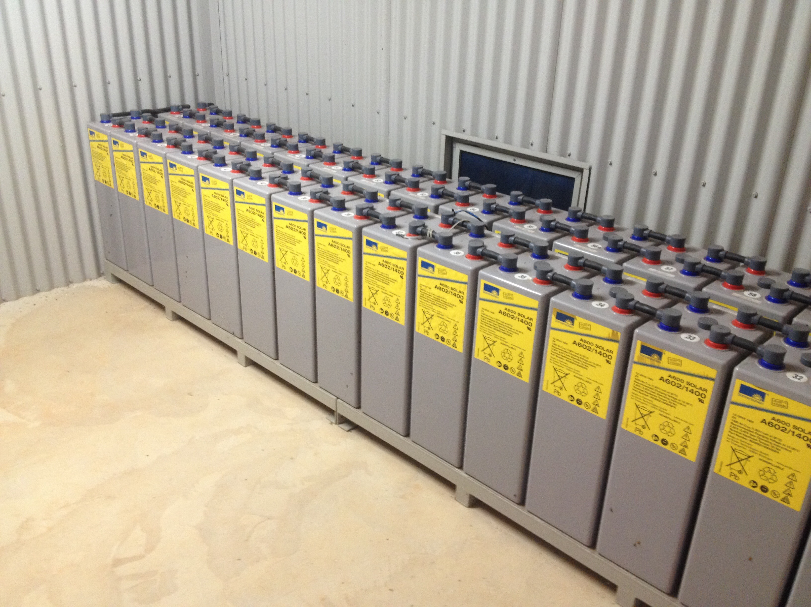
Stand-Alone Inverters
Stand-alone inverters use batteries for DC power input.
  PV arrays or other DC sources are used to charge the battery independently.
  Common DC input voltage 12 V, 24 V and 48 V for residential application, up to 480 V for industrial applications.
Supply power to AC loads is isolated from the grid; the inverter power rating dictates maximum AC load.
Often include battery charger function for using an independent AC input source (e.g., generator or grid)
  Cannot synchronize with and feed power back into the grid.
The output power rating must be at least equal to the single largest connected load.
Qurren [CC BY-SA 4.0]. Retrieved from https://commons.wikimedia.org/wiki/File:Meltec_car_power_inverter_SIV-300.jpg
Stephan Ridgway [CC BY 2.0]. Retrieved from https://www.flickr.com/photos/stephanridgway/14141342129
Notes:
Stand alone inverters can some times create very poor sine waves. In off grid inverters, you get what you pay for and cheap or bad sine wave can damage equipment.

Slide 7
Utility-Interactive Inverters
All listed interactive inverters produce utility-grade sine wave output and include anti-islanding safety features to de-energize inverter output to the grid upon loss of grid voltage. This will prevent anyone from getting a shock if he or she is working on the power lines when the power is down.
Interactive inverters use PV arrays for DC power input and supply synchronized AC output power in parallel with the utility grid.
Because a grid tied inverter will send its excess electricity to the grid, it is important that the sine wave created by the inverter is top quality. Poor sine waves could damage motors, computers, and sensitive equipment.
Notes:
Sometimes call string inverters, inverters series connect modules to reach the right voltage that the inverter calls for. When there is shading on one module in a string it will slow down the whole string like a battery with a bad cell.

Slide 8
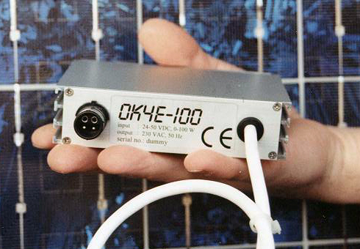
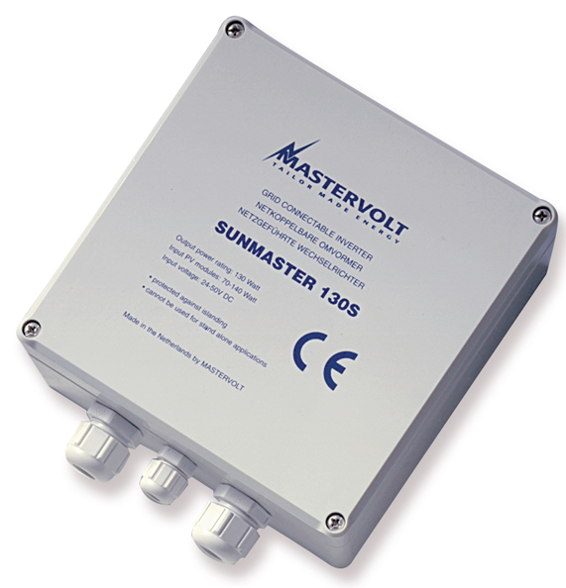
Micro inverters
Micro inverters are small Grid Tied inverters that are mounted behind each of the Modules.
Used primarily for residential and small commercial applications
Can achieve greater energy harvest from partially-shaded and multi-directional arrays
OK-Services [CC BY 3.0]. Retrieved from https://en.wikipedia.org/wiki/File:OK4E-100.jpg
Mastervolt [CC BY-SA 3.0]. Retrieved from https://commons.wikimedia.org/wiki/File:Sunmaster_130.jpg
Notes:
There are micro inverters that have two modules per micro inverters. Micro inverters are great for situations where shading can be a problem.

Slide 9
Bimodal Inverters
Bimodal inverters use batteries for DC power input and may operate in either interactive or stand-alone mode.
In interactive mode, the inverter produces AC power output in proportion to PV array production, while maintaining a prescribed maximum battery voltage.
Upon loss of grid voltage, the inverter automatically transfers to stand-alone mode, and powers backup loads isolated from grid.
Bimodal inverters may also include load control, battery charging, and generator starting functions.
Notes:
Bimodal inverters are complicated and generally have a small battery bank made for critical loads, like a medication refrigerator. They do combine the best of both world but need work.

Slide 10
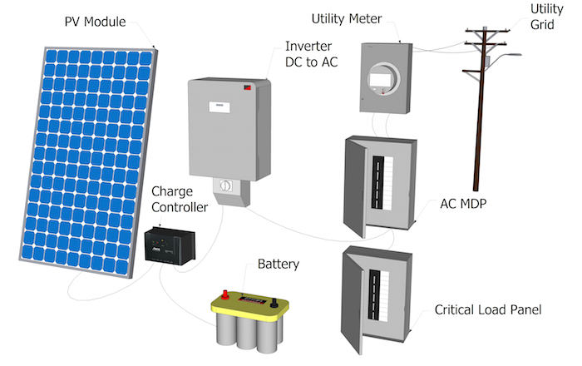
Bimodal Inverters System
Mohamed Amer Chaaban [CC BY 4.0]. Retrieved from https://www.e-education.psu.edu/ae868/node/872
Notes:
On continuous cloudy days the bimodal system will use the grid to charge the battery bank. This mean you always have a fully charged battery bank.

Slide 11
Conclusion
Upon completing this unit, students should be able to
Distinguish between AC and DC sine waves
Explain inverter operation
Explain an inverter string
Compare stand alone inverters vs interconnected
Explain the differences in various inverters
“This presentation was prepared by Northeast Iowa Community College under award EG-17-004 from the Iowa Energy Center. Any opinions, findings, and conclusions or recommendations expressed in this material are those of the author(s) and do not necessarily reflect the views of the Iowa Energy Center.”

